Slide 1
ἐνοικέω – dwell within and influence for good
But if the Spirit of Him who raised Jesus from the dead dwells in you, He who raised Christ from the dead will also give life to your mortal bodies through His Spirit who dwells in you. Rom. 8:11
Let the word of Christ dwell in you richly in all wisdom; teaching and admonishing one another in psalms and hymns and spiritual songs, singing with grace in your hearts to the Lord. Col. 3:16

Slide 3
Romans 12:9
ἀνυπόκριτος
Love must be sincere – NIV
Let love be genuine – ESV
Let love be without hypocrisy – NKJV
Don’t just pretend to love others. Really love them. – NLT
Love from the center of who you are; don’t fake it. - Message

Slide 4
“The true spirit of prayer is no other than God’s own Spirit dwelling in the hearts of the saints.”
Jonathan Edwards

Slide 7
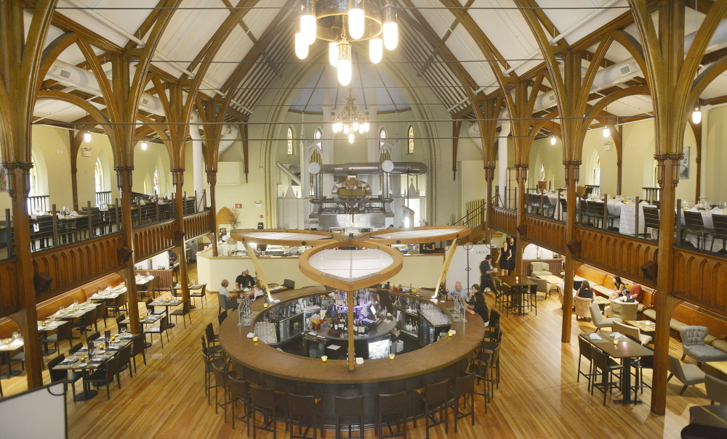

Slide 8
