Slide 2
I am becoming a Spirit-filled Christian as each day I incarnate…
1. Integrity

Slide 3
Integrity: “The state of being unimpaired; soundness. The quality or condition of being whole or undivided; completeness.”
--American Heritage Dictionary

Slide 4
Ephesians 5:18
Don’t be drunk with wine, because that will ruin your life. Instead, be filled with the Holy Spirit…
“ruin” = asotia = “not whole, not full”

Slide 5
Galatians 5:22-23 (RSV)
But the fruit of the Spirit is love, joy, peace, patience, kindness, goodness, faithfulness, gentleness, self-control; against such there is no law.

Slide 6
I am becoming a Spirit-filled Christian as each day I incarnate…
2. Love

Slide 7
John 13:35
“Your love for one another will prove to the world that you are my disciples.”

Slide 8
Ephesians 5:1-2
Imitate God, therefore, in everything you do, because you are his dear children. Live a life filled with love, following the example of Christ. He loved us and offered himself as a sacrifice for us, a pleasing aroma to God.

Slide 9
1 Corinthians 13:1
If I could speak all the languages of earth and of angels, but didn’t love others, I would only be a noisy gong or a clanging cymbal.

Slide 10
1 Corinthians 13:2
If I had the gift of prophecy, and if I understood all of God’s secret plans and possessed all knowledge, and if I had such faith that I could move mountains, but didn’t love others, I would be nothing.

Slide 11
1 Corinthians 13:3
If I gave everything I have to the poor and even sacrificed my body, I could boast about it; but if I didn’t love others, I would have gained nothing.

Slide 12


Slide 13
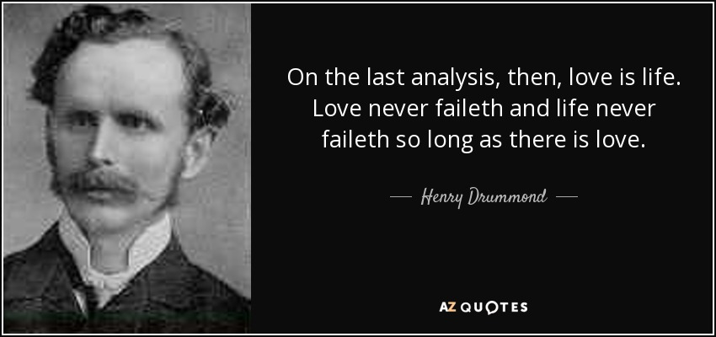

Slide 14
I am becoming a Spirit-filled Christian as each day I incarnate…
3. Gratitude

Slide 15
Ephesians 5:18-20
Don’t be drunk with wine, because that will ruin your life. Instead, be filled with the Holy Spirit, singing psalms and hymns and spiritual songs among yourselves, and making music to the Lord in your hearts. And give thanks for everything to God the Father in the name of our Lord Jesus Christ.

Slide 16
And the church is his body; it is made full and complete by Christ… Eph. 1:23
May you experience the love of Christ…Then you will be made complete with all the fullness of life and power that comes from God. Eph. 3:19
…that we will be mature in the Lord, measuring up to the full and complete standard of Christ. Eph. 4:13

