Slide 2
A
Time
to
Psalm!

Slide 5
Montreal ordinance: “Every one who not being in a dwelling-house, causes a disturbance in or near a public place, by screaming or shouting or singing is guilty of an offence punishable on summary conviction.”

Slide 7
We Gather
Shout with joy to the Lord,
all the earth!
Worship the Lord with gladness.
Come before him, singing with joy.

Slide 8
“To gather with God's people in united adoration of the Father is as necessary to the Christian life as prayer.”
--Martin Luther

Slide 10
We Magnify
Acknowledge that the Lord is God!
He made us, and we are his.
We are his people, the sheep of
his pasture.
Enter his gates with thanksgiving;
go into his courts with praise.

Slide 11
Psalm 93-100
Enthronement Psalms

Slide 12
“Adoration is the spontaneous yearning of the heart to worship, honor, magnify, and bless God. We ask nothing but to cherish him. We seek nothing but his exaltation. We focus on nothing but his goodness. We put our energy and our passion into magnifying Him.”
-- Richard Foster

Slide 13
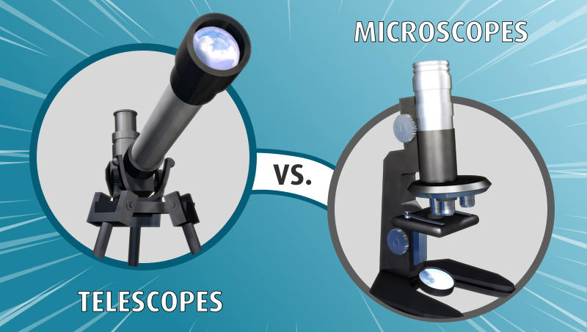

Slide 14
7 Mandates
Shout (applaud, laud)
Worship
Come before
Acknowledge
Enter
Go
Give thanks

Slide 15
We Love
For the Lord is good.
His unfailing love continues
forever,
and his faithfulness continues to each generation.

Slide 16
