Slide 2
Finding Our Way Home
3-Part Series

Slide 3
COMING HOME
LUKE 15:20-24

Slide 4
Homeless Son
→ Prodigal Father

Slide 5
“No story more instantly touches the nerve of actual life. Let it be read without any comment or explanation, and it conquers us.” --George Buttrick

Slide 6
The Father Longs for Our Return
Verse 20a:
So he returned home to his father. And while he was still a long way off, his father saw him coming.

Slide 7
The Father Feels Deeply
When We Return
Verse 20b
Filled with love and compassion, he ran to his son, embraced him, and kissed him.

Slide 8
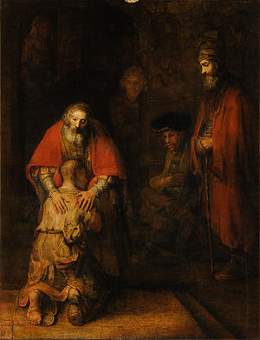

Slide 9
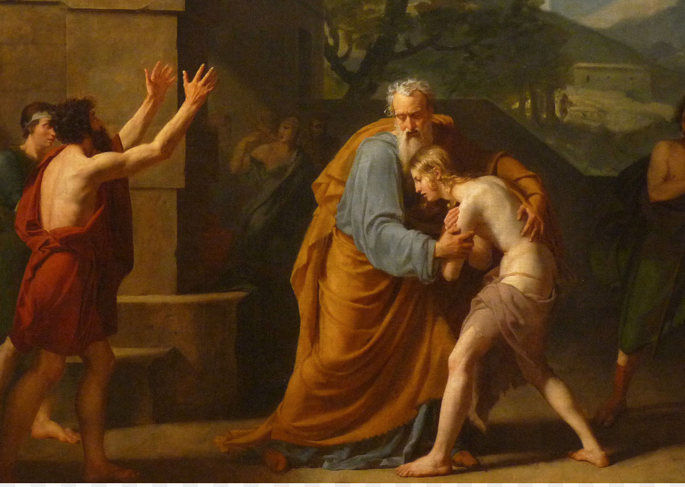

Slide 10
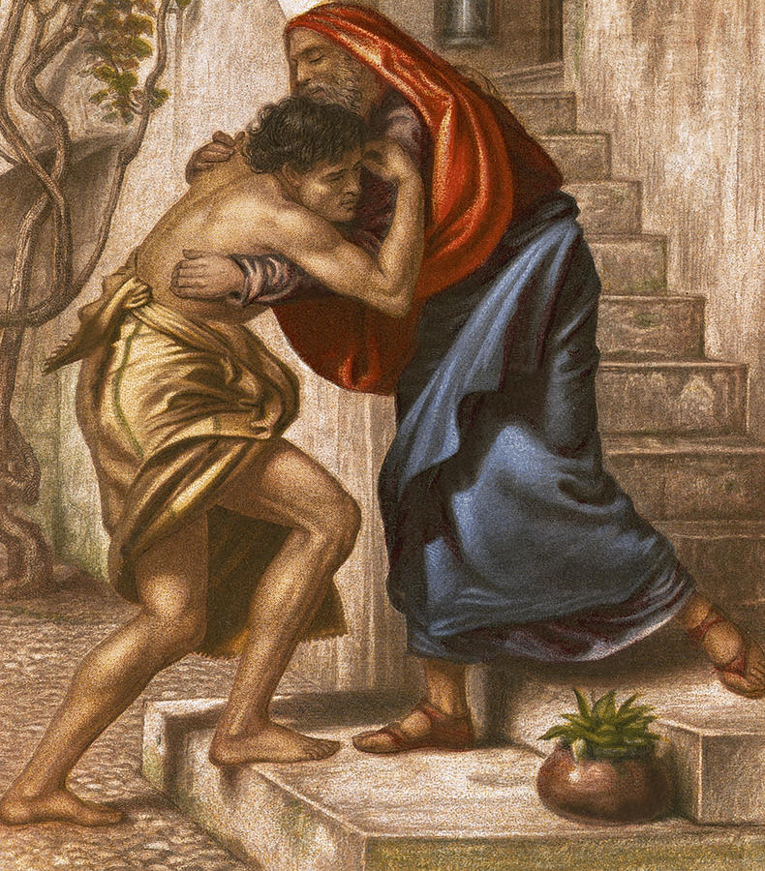

Slide 11
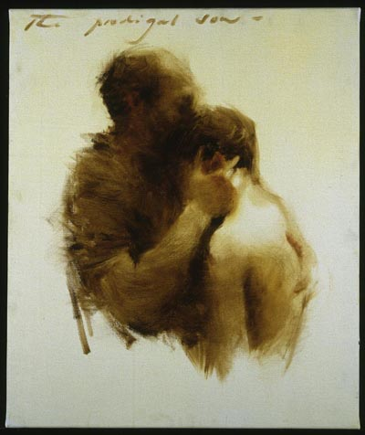

Slide 12
The Father Celebrates Our Return
Verses 18-19
I will go home to my father and say, “Father, I have sinned against both heaven and you, and I am no longer worthy of being called your son. Please take me on as a hired servant.”

Slide 13
Verses 21-22
His son said to him, “Father, I have sinned against both heaven and you, and I am no longer worthy of being called your son.”
But his father said to the servants, “Quick! Bring the finest robe in the house and put it on him. Get a ring for his finger and sandals for his feet.”

Slide 14
Father gifts the son with…
A Royal Welcome → The Robe
A Permanent Family → The Ring
A Release from Slavery → The Sandals
A Celebration of Redemption → The Calf

Slide 15
Coming Home Means
Going Back Out
Verse 14
…a great famine swept over the land, and he began to starve.

Slide 16
Verse 22
But his father said to the servants, “Quick! Bring the finest robe in the house and put it on him. Get a ring for his finger and sandals for his feet. And kill the calf we have been fattening.”

