Slide 2
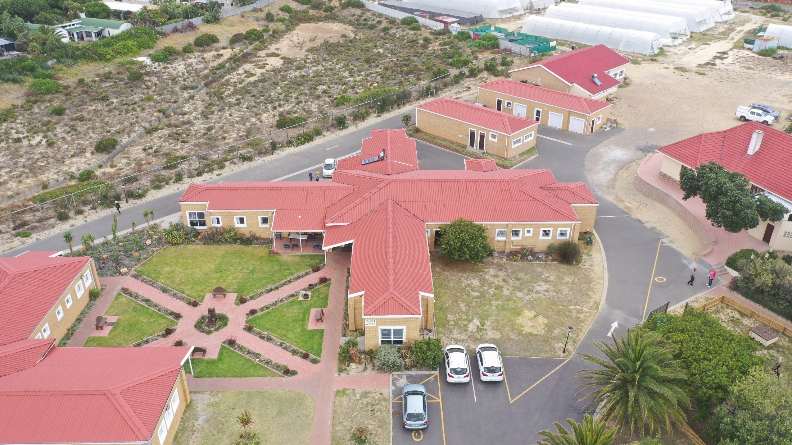

Slide 4
Love God
Love People

Slide 5
The Great Commandment
Matthew 22:36-40 36 “Teacher, which is the greatest commandment in the Law?” 37 Jesus replied: “‘Love the Lord your God with all your heart and with all your soul and with all your mind.’ 38 This is the first and greatest commandment. 39 And the second is like it: ‘Love your neighbour as yourself.’ 40 All the Law and the Prophets hang on these two commandments.”

Slide 6
Love God
Matthew 22:37 37 Jesus replied: ‘Love the Lord your God with all your heart and with all your soul and with all your mind.’ 38 This is the first and greatest commandment.
You need to love God by telling Him
Tell Him with feeling

Slide 7
You need to love God by
obeying Him
John 14:15 15 “If you love Me, you will obey what I command”
You need to love God by
serving Him

Slide 8
Love People
Matthew 22:39 39 The second is like it: ‘Love your neighbour as yourself.’

Slide 9
Love People
Love one another like Jesus loved
1 John 3:16 17 This is how we know what love is: Jesus Christ laid down His life for us. And we ought to lay down our lives for our brothers.

Slide 10
Love People
Love one another sacrificially
1 John 3:17 17 If anyone has material possessions and sees his brother in need but has no pity on him, how can the love of Jesus be in him?

Slide 11
Matthew 25:37- 40
37 “Then the righteous will answer him, ‘Lord, when did we see you hungry and feed you, or thirsty and give you something to drink? 38 When did we see you a stranger and invite you in, or needing clothes and clothe you? 39 When did we see you sick or in prison and go to visit you?’
40 “The King will reply, ‘I tell you the truth, whatever you did for one of the least of these brothers of mine, you did for me.’

