Slide 2


Slide 3
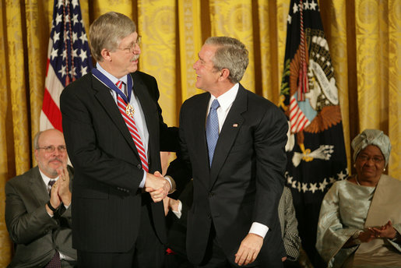

Slide 4
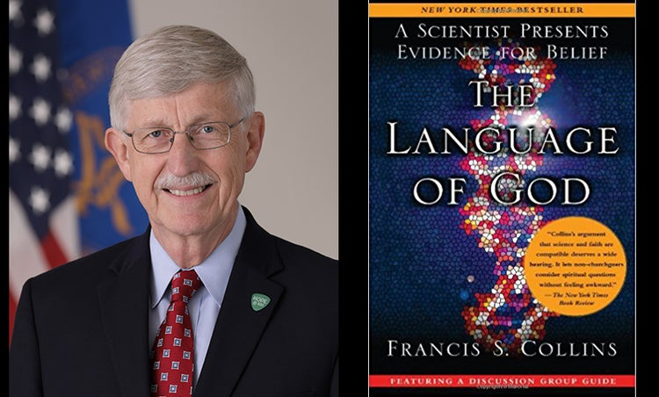

Slide 5
...I witnessed numerous cases of individuals whose faith provided them with a strong reassurance of ultimate peace, be it in this world or the next...”

Slide 6


Slide 8
Lead us

Slide 9
Savior Like a Shepherd Lead Us
We are Thine, who Thou befriend us
Be the guardian of our way
Keep Thy flock from sin defend us
Seek us when we go astray

Slide 10
“Lead us!”

Slide 11
Not into temptation

Slide 12
James 1:13
When tempted, no one should say, “God is tempting me.” For God cannot be tempted by evil, nor does He tempt anyone.

Slide 13
“Lead us, not into temptation”

Slide 14
Πειρασμός
“Temptation” or “Test”

Slide 15
extrinsic religiosity: those who tend to engage religion for its personal and social benefits → reported more fearful and
anxiety-laden responses.
intrinsic religiosity: those motivated by a religious framework who attempt to live out their faith accordingly. These individuals for whom their faith appeared to be more central to their daily life → reported significantly less fearful views.

Slide 16


Slide 18
Diabolos
“throw in front of”

Slide 19
But deliver us from evil

Slide 20
John 17:15
“My prayer is not that you take them out of this world but that you protect them from the evil one."

Slide 21
Philippians 1:19
“...all these things will
lead to my deliverance!”

Slide 22
John 10:10
“The thief comes only to steal and kill and destroy; I have come that they may have life, and have it to the full!”

Slide 23
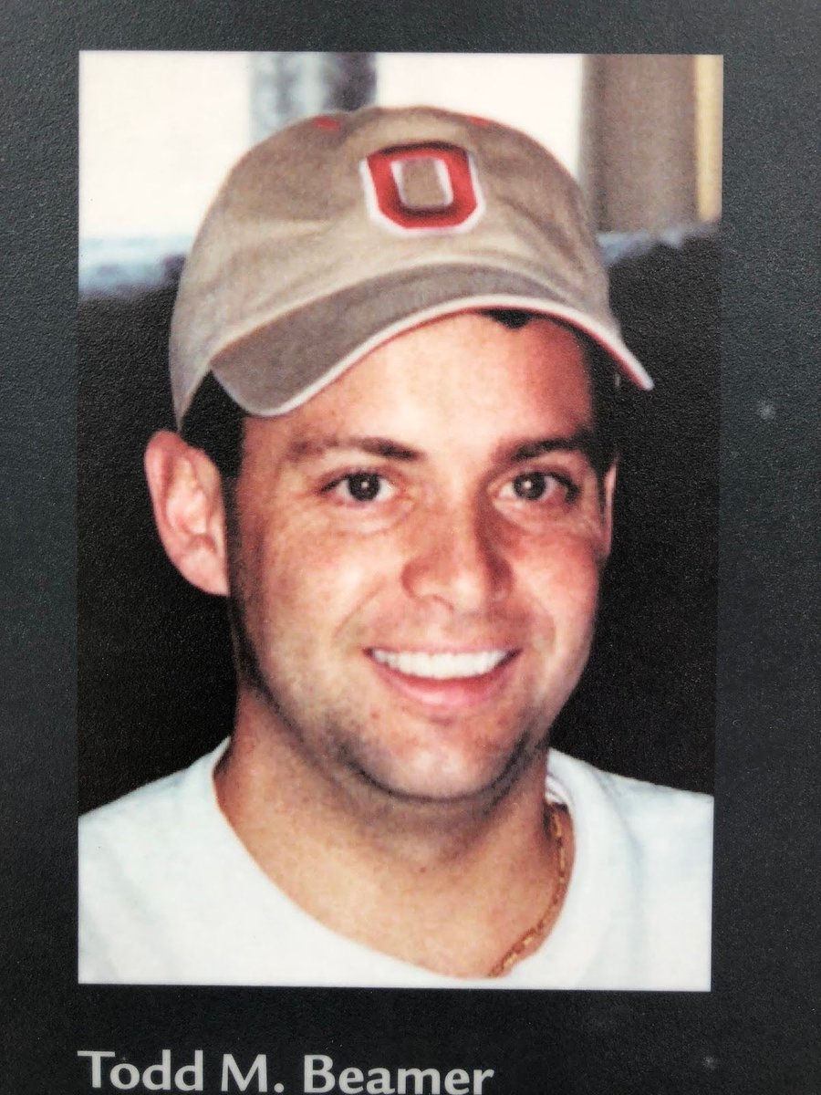

Slide 25
James 1:12
Blessed is the man who perseveres under trial, because when he has stood the test, he will receive the crown of life that God has promised to those who love him.

Slide 27
For Thine is
the Kingdom

Slide 28
coda
“A passage of more or less independent character introduced after the completion of the essential parts of a movement, so as to form a more definite and satisfactory conclusion.”

