Slide 4
1 Samuel 17:26
“Who is this pagan Philistine anyway, that he is allowed to defy the armies of the living God?”

Slide 5
Verse 33
“Don’t be ridiculous!” Saul replied. “There’s no way you can fight this Philistine and possibly win! You’re only a boy, and he’s been a man of war since his youth.”

Slide 6
But David persisted. “I have been taking care of my father’s sheep and goats,” he said. “When a lion or a bear comes to steal a lamb from the flock, I go after it with a club and rescue the lamb from its mouth. If the animal turns on me, I catch it by the jaw and club it to death. I have done this to both lions and bears, and I’ll do it to this pagan Philistine, too, for he has defied the armies of the living God!

Slide 7
Verse 39
“I can’t go in these,” he protested to Saul. “I’m not used to them.” So David took them off.

Slide 8
3 Kinds of Warriors
Cavalry (Horses and Chariots)
Infantry (Foot soldiers)
Artillery (Projectile Warriors: Archers and Slingers)

Slide 9
Judges 20:16
Among Benjamin’s elite troops, 700 were left-handed, and each of them could sling a rock and hit a target within a hairsbreadth without missing.

Slide 10
1 Samuel 17:40
He picked up five smooth stones from a stream and put them into his shepherd’s bag. Then, armed only with his shepherd’s staff and sling, he started across the valley to fight the Philistine.

Slide 13
Verse 43
“Am I a dog,” he roared at David, “that you come at me with a stick?” And he cursed David by the names of his gods.

Slide 14
Verse 45
David replied to the Philistine, “You come to me with sword, spear, and javelin, but I come to you in the name of the Lord of Heaven’s Armies—the God of the armies of Israel, whom you have defied.”

Slide 15
Verse 48
As Goliath moved closer to attack, David quickly ran out to meet him.

Slide 18
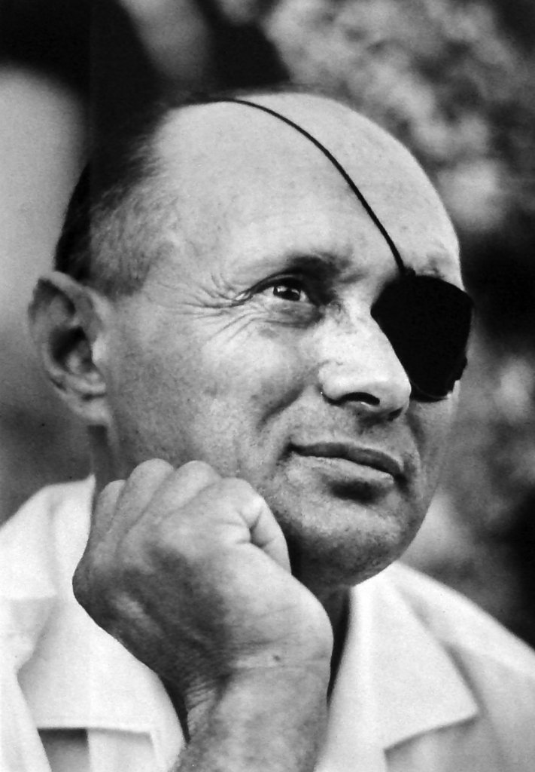
“David fought Goliath not with inferior but (on the contrary) with superior weaponry. And his greatness consisted not in his being willing to go into battle against someone far stronger than he was, but in his knowing how to exploit a feeble weapon by which a feeble person could seize the advantage and become stronger.”

Slide 20
Mark 6:37
But he answered, “You give them something to eat.”
They said to him, “That would take more than half a year’s wages! Are we to go and spend that much on bread and give it to them to eat?”

Slide 21
Verse 38
“How much bread do you have?” he asked. “Go and find out.”
They came back and reported, “We have five loaves of bread and two fish.”

