Slide 2
Breathe: Holy Spirit Acting
through Me
Empowering Me to Go Where It’s Uncomfortable
Acts 9 & 22

Slide 3
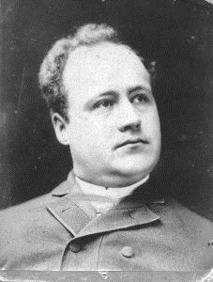

Slide 4
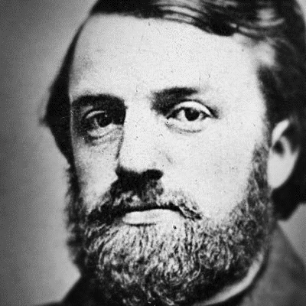

Slide 5
Ananias influenced millions
because…

Slide 6
He was devout.

Slide 7
Acts 22:12
(Paul): “A man named Ananias lived there. He was a godly man, deeply devoted to the law, and well regarded by all the Jews of Damascus.”

Slide 8
“Integrity”…
But the Holy Spirit produces this kind of fruit in our lives: love, joy, peace, patience, kindness, goodness, faithfulness, gentleness, and self-control.
--Galatians 5:22-23

Slide 9
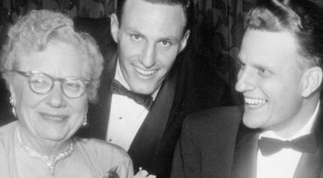

Slide 10
To be “godly”…
“Love when you expect no love in return.
Do good without expecting thanks.
Lend when you do not hope for a return.
This will make us act like the sons and daughters of the Most High.”
--Henrietta Mears

Slide 11
Deeply devoted

Slide 12
He pursued the ultimate goal.

Slide 13
Acts 9:17
So Ananias went and found Saul. He laid his hands on him and said, “Brother Saul, the Lord Jesus, who appeared to you on the road, has sent me so that you might regain your sight and be filled with the Holy Spirit.”

Slide 14
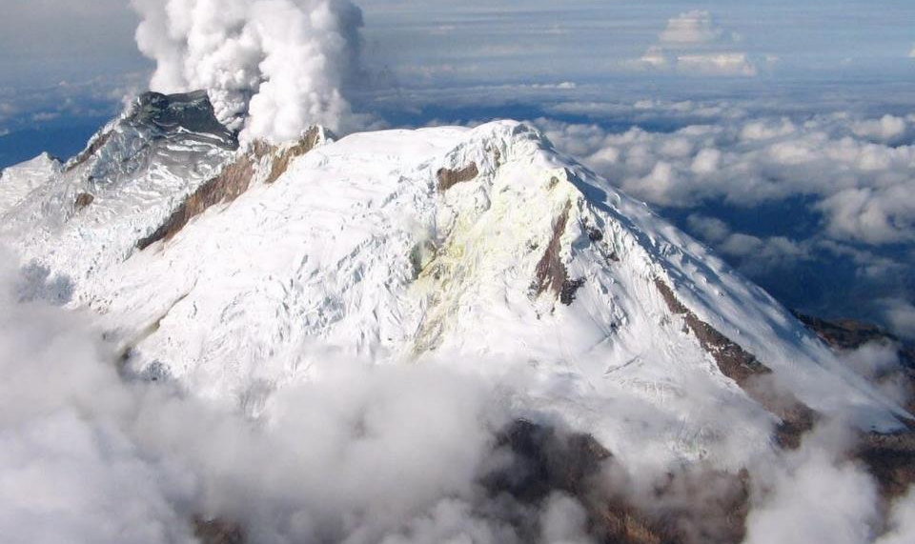

Slide 15
He did not wait.

Slide 16
Acts 9:15
But the Lord said, “Go, for Saul is my chosen instrument to take my message to the Gentiles and to kings, as well as to the people of Israel.

Slide 17
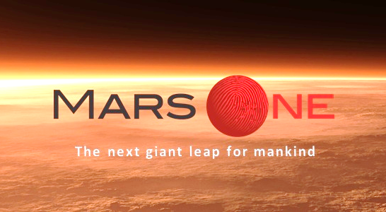

Slide 18
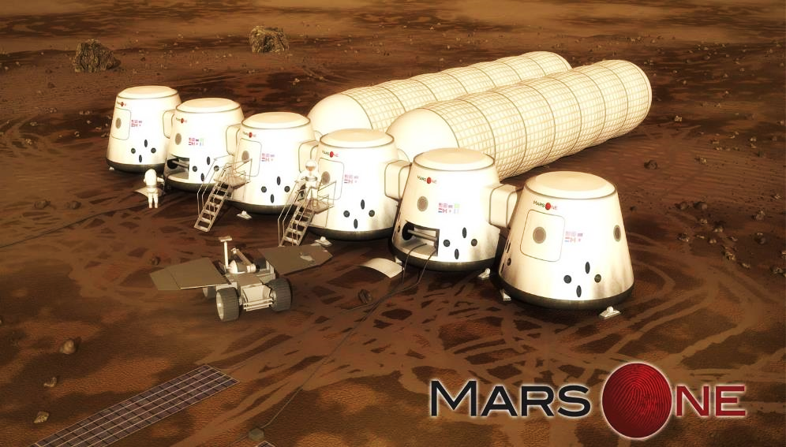

Slide 19
Acts 22:15-16
‘…you (Paul) are to be his witness, telling everyone what you have seen and heard. What are you waiting for? Get up and be baptized. Have your sins washed away by calling on the name of the Lord.’

Slide 20
He became part of another’s testimony.

Slide 21
Acts 26:19-23
“And so, King Agrippa, I obeyed that vision from heaven. I preached first to those in Damascus, then in Jerusalem and throughout all Judea, and also to the Gentiles, that all must repent of their sins and turn to God—and prove they have changed by the good things they do. Some Jews arrested me in the Temple for preaching this, and they tried to kill me…

Slide 22
…But God has protected me right up to this present time so I can stand here and testify to everyone, from the least to the greatest. I teach nothing except what the prophets and Moses said would happen—that the Messiah would suffer and be the first to rise from the dead, and in this way announce God’s light to Jews and Gentiles alike.”

Slide 25
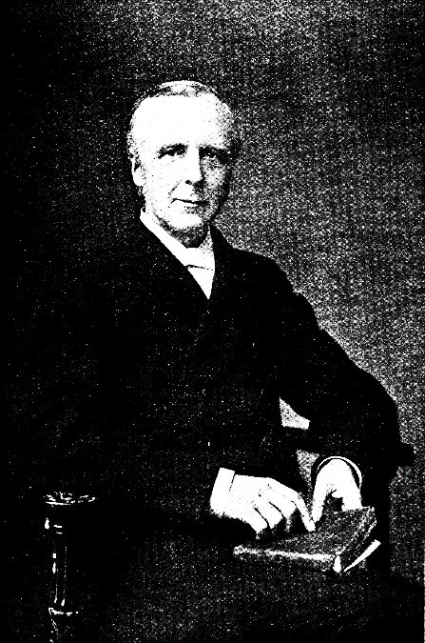

Slide 26
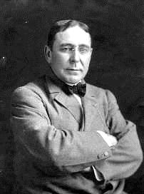

Slide 27
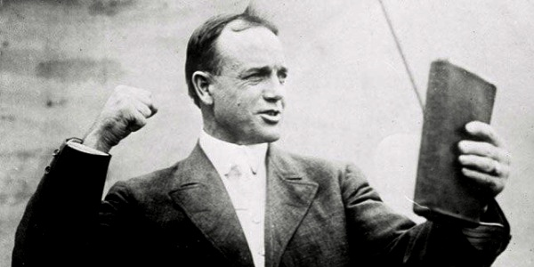

Slide 28
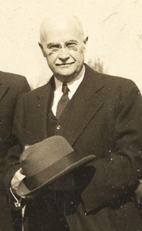

Slide 29
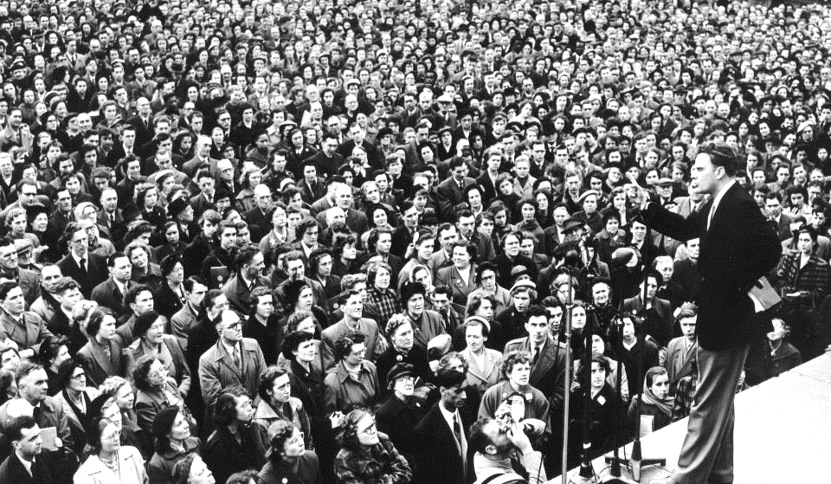

Slide 30
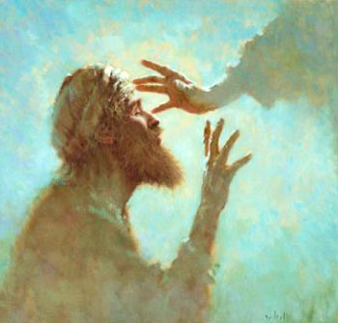

Slide 31
“Now what are you waiting for? Get up, be baptized and have your sins washed away, calling on the name of the Lord.”

