Slide 2
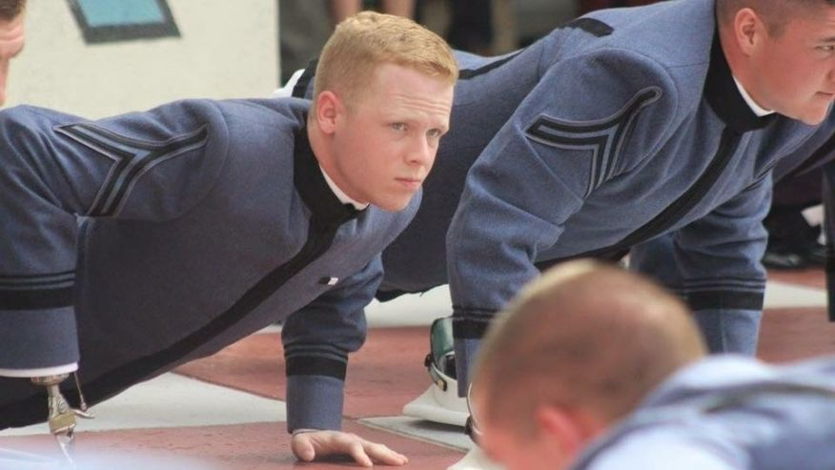

Slide 3
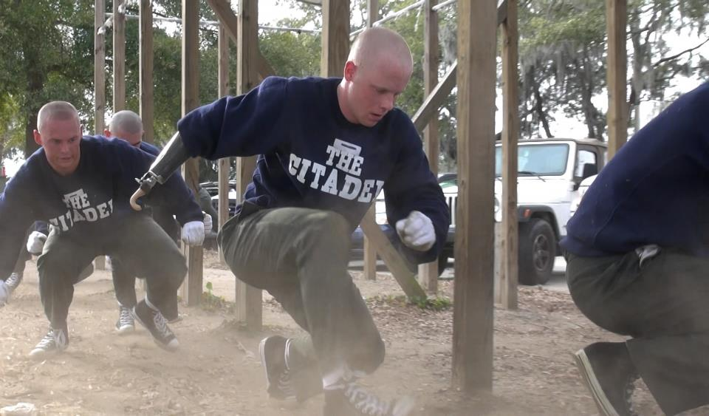

Slide 4
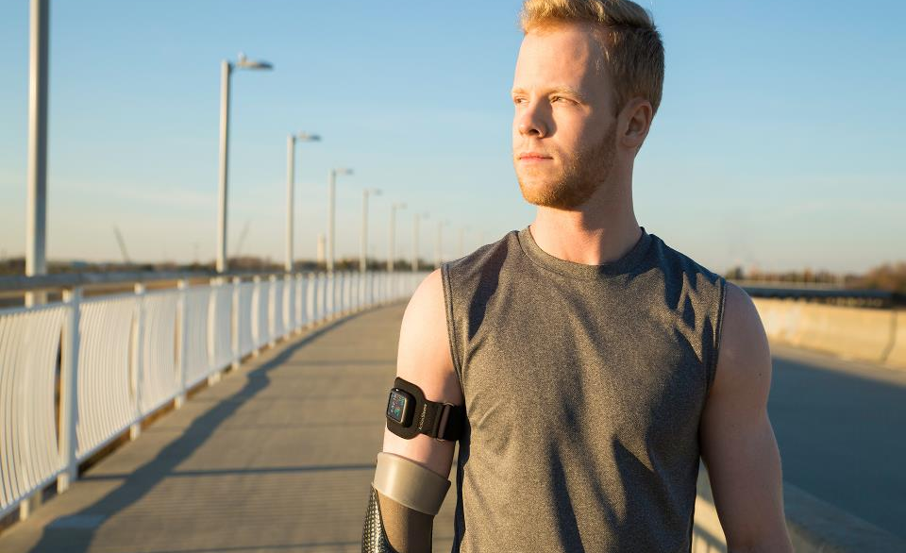

Slide 5
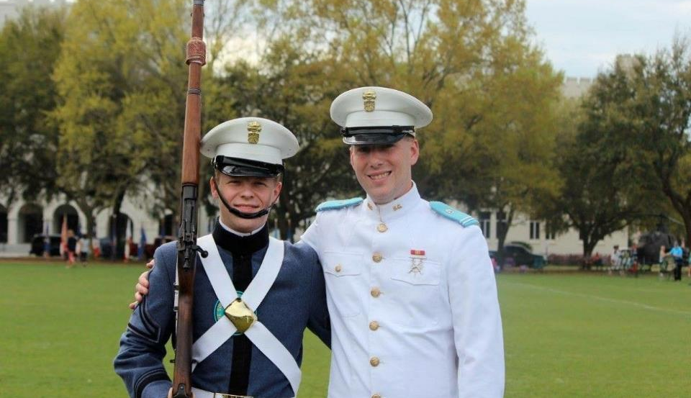

Slide 7
Psalm 18:1-2
I love you, Lord;
you are my strength…
He is my shield, the power that saves me,
and my place of safety.

Slide 8
He is a shield for all who look to him for protection…
God arms me with strength,
and he makes my way perfect…
He trains my hands for battle;
he strengthens my arm to draw a bronze bow.
You have given me your shield of victory.

Slide 9
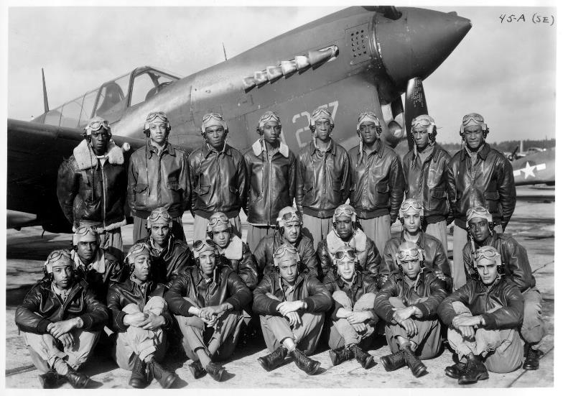

Slide 10
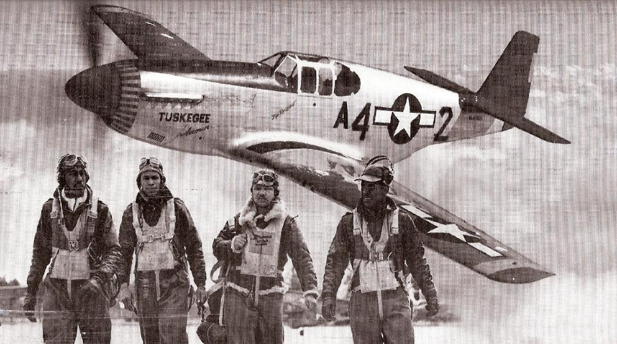

Slide 11
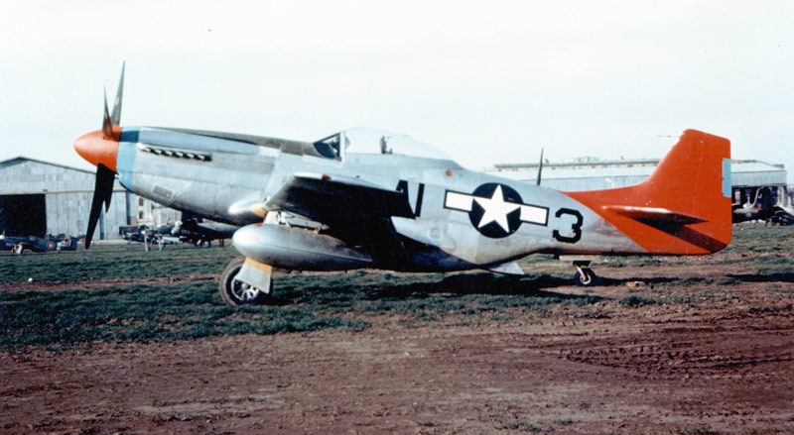

Slide 12
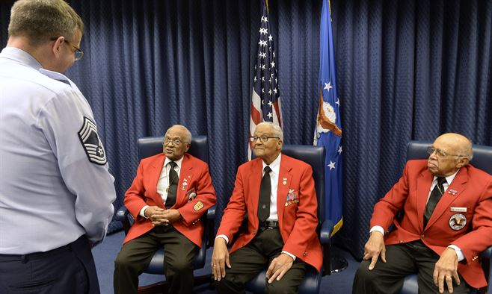

Slide 13
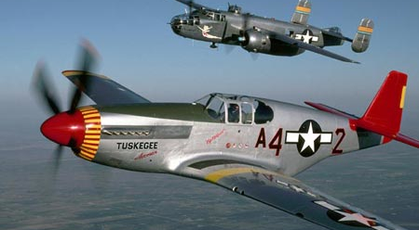

Slide 14
Ephesians 6:14,16
Stand firm then, with the belt of truth buckled around your waist, with the breastplate of righteousness in place…take up the shield of faith, with which you can extinguish all the flaming arrows of the evil one.

