Slide 2


Slide 4
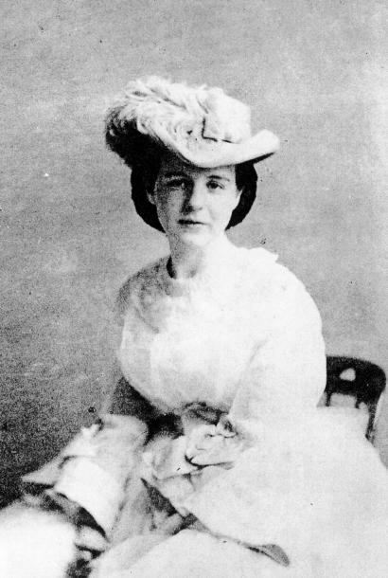

Slide 5
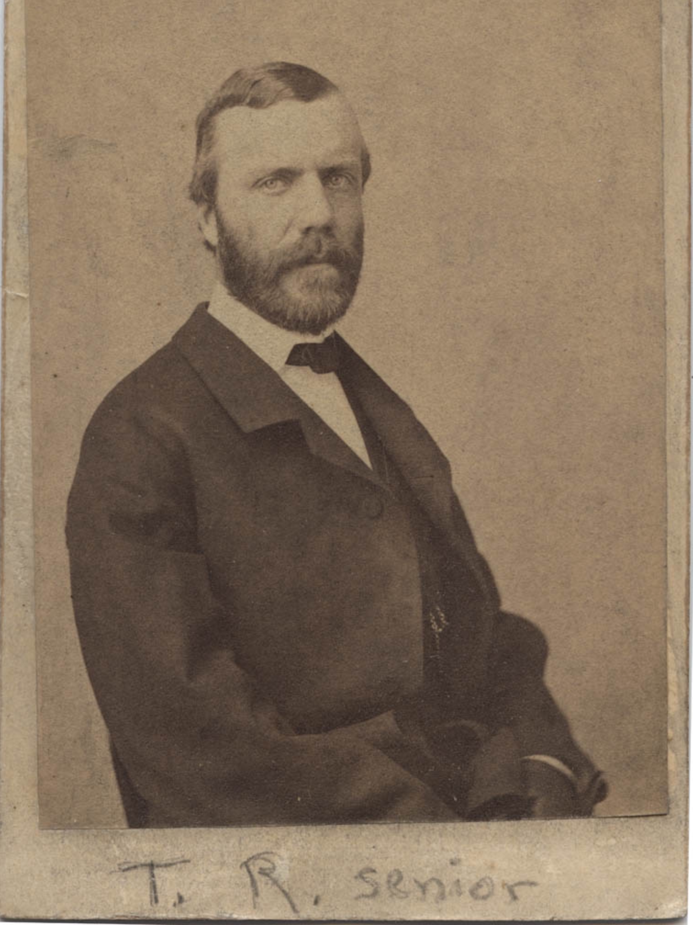
“Great Heart”

Slide 7
Philippians 1:18b-19
And I will continue to rejoice. For I know that as you pray for me and the Spirit of Jesus Christ helps me, this will lead to my deliverance.

Slide 8
Verses 20-21
For I fully expect and hope that I will never be ashamed, but that I will continue to be bold for Christ, as I have been in the past. And I trust that my life will bring honor to Christ, whether I live or die. For to me, living means living for Christ, and dying is even better.

Slide 9
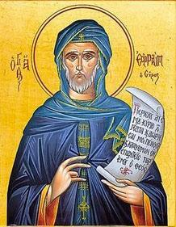
“Our death is already behind us, and our resurrection before us.”
Ephrem the Syrian (306-373 AD)

Slide 10
Verses 23-25
I’m torn between two desires: I long to go and be with Christ, which would be far better for me. But for your sakes, it is better that I continue (remain) to live.
Knowing this, I am convinced that I will remain alive so I can continue to help all of you grow and experience the joy of your faith.

Slide 11
Verses 25-26
Knowing this, I am convinced that I will remain alive so I can continue to help all of you grow and experience the joy of your faith. And when I come to you again, you will have even more reason to take pride in Christ Jesus because of what he is doing through me.

Slide 13
“True courage is
letting love win”

