Slide 2
I AM A MISSIONARY

Slide 3
I AM A
FUNCTIONING
MISSIONARY

Slide 4
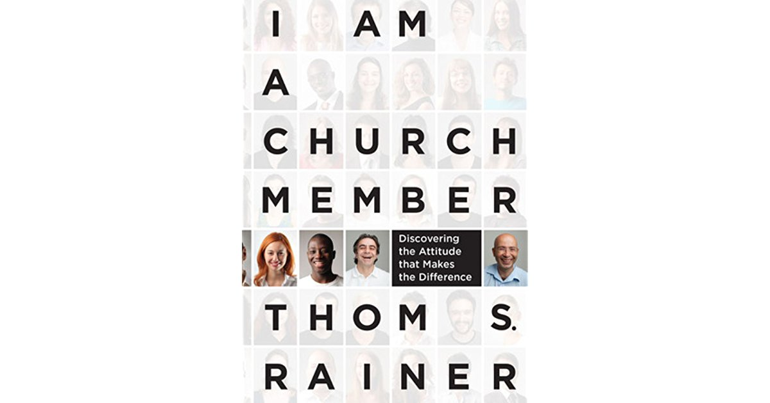

Slide 5
9 out of 10 churches in America are declining
2/3 of the Builder generation (b. before 1946) are Christians
Only 15% of Millennials (b. 1980-2000) are Christians
80 million Millennials=largest generation in history
“We have all but lost that generation. We can blame it on culture, godless politics, poor leadership. We need to look at ourselves. Many of us have lost the Biblical understanding of what it means to be a part of the body of Christ.”

Slide 6
MEMBER → MISSIONARY→
FUNCTIONING MISSIONARIES

Slide 7
1. As a Functioning Missionary, I will be a Saint who Shows Up.

Slide 8
OT “holy” = qodesh = “other than, apartness”
NT “holy” = hagios = “saint, holy person, one set apart”

Slide 9
Paul’s Opening Salutations:
Romans: Paul, a servant of Jesus Christ, called to be an apostle, set apart for the gospel of God…To all God’s beloved in Rome, who are called to be saints…
1 Corinthians: Paul, called to be an apostle of Christ Jesus…To the church of God that is in Corinth, to those who are sanctified in Christ Jesus, called to be saints…
2 Corinthians: Paul, an apostle of Christ Jesus by the will of God…To the church of God that is in Corinth, to all the saints…

Slide 10
Galatians: Paul an apostle—sent (appointed)…by Jesus Christ and God the Father, who raised him from the dead—To the churches of Galatia…
Ephesians: Paul, an apostle of Christ Jesus by the will of God…To the saints who are in Ephesus and are faithful in Christ Jesus…
Philippians: Paul…servant of Christ Jesus…To all the saints in Christ Jesus who are in Philippi…
Colossians: Paul, an apostle of Christ Jesus by the will of God…To the saints and faithful brothers and sisters in Christ in Colossae…

Slide 11
Hebrews 10:24-25
And let us consider how to provoke one another to love and good deeds, not neglecting to meet together, as is the habit of some, but encouraging one another, and all the more as you see the Day approaching.

Slide 12
2013 Barna Group Survey
30% = attending church is very important
40% = ambivalent about attending church
30% = attending church is not important at all
Ambivalent:
40% = “I can find God elsewhere”
35% = “It is not personally relevant”

Slide 13
1 Corinthians 6:19 (NLT)
Don’t you realize that your (plural—soma humon) body is the temple (singular-naos) of the Holy Spirit, who lives in you and was given to you by God?

Slide 14
“As a Functioning Missionary,
I will be a Saint who Shows up!”

Slide 15
2. As a Functioning Missionary,
I will be a Stakeholder who Supplies.

Slide 16
1 Corinthians 12:12,18-21,27
For just as the body is one and has many members, and all the members of the body, though many, are one body, so it is with Christ…God arranged the members in the body, each one of them, as he chose. If all were a single member, where would the body be? As it is, there are many members, yet one body. The eye cannot say to the hand, “I have no need of you,” nor again the head to the feet, “I have no need of you…You are the body of Christ and individually members of it.

Slide 17
“The Body of Christ metaphor asserts, at the very least, that an individual apart from a congregation is a form of life that the New Testament does not envision.”
--William Willimon

Slide 18
“As a Functioning Missionary,
I will be a Stakeholder who Supplies!”

Slide 19
3. As a Functioning Missionary,
I will be a Slave who is Sent.

Slide 20
“servant” = doulos =“slave”
“apostle” = apostello = “sent one”
“church” = ecclesia = “called out”

Slide 21
Paul’s Opening Salutations:
Romans: Paul, a servant of Jesus Christ, called to be an apostle, set apart for the gospel of God…To all God’s beloved in Rome, who are called to be saints…
1 Corinthians: Paul, called to be an apostle of Christ Jesus…To the church of God that is in Corinth, to those who are sanctified in Christ Jesus, called to be saints…
2 Corinthians: Paul, an apostle of Christ Jesus by the will of God…To the church of God that is in Corinth, to all the saints…

Slide 22
Galatians: Paul an apostle—sent (appointed)…by Jesus Christ and God the Father, who raised him from the dead—To the churches of Galatia…
Ephesians: Paul, an apostle of Christ Jesus by the will of God…To the saints who are in Ephesus and are faithful in Christ Jesus…
Philippians: Paul…servant of Christ Jesus…To all the saints in Christ Jesus who are in Philippi…
Colossians: Paul, an apostle of Christ Jesus by the will of God…To the saints and faithful brothers and sisters in Christ in Colossae…

Slide 23
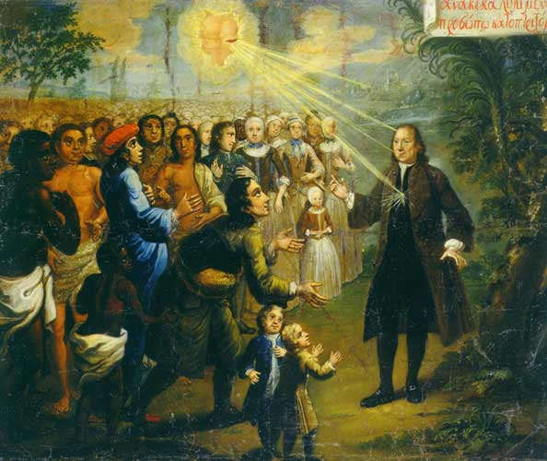

Slide 24
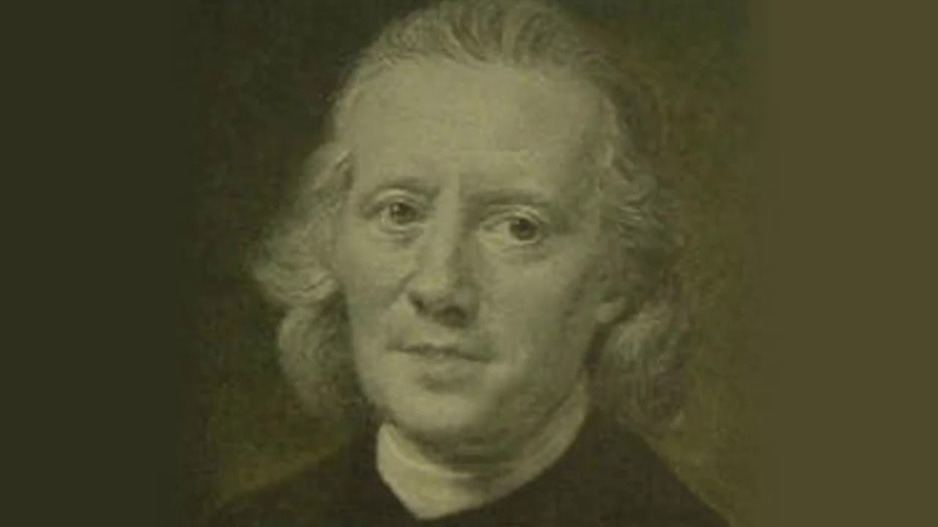

Slide 25
“They were warned that the slaves work so long and so severely were they worked by their masters, that, unless those who went to preach to them would consent to become slaves themselves, and labour with the slaves in the plantations, they would have little opportunity of communicating divine instruction to them…

Slide 26
“…This intelligence did not in the smallest degree daunt the devoted young men; they were both ready, not only to be bound, but to die for the Lord Jesus. “We shall work as slaves among the slaves,” they replied. Such indeed was the simplicity of purpose, singleness of heart, and strength of faith, by which they were actuated, that they were willing to make any sacrifice which might be required, if they could win but one soul to Christ”

Slide 27
Johann Leonard Dober, 1732: “When the gracious count told me about the slaves, it gripped me so that I could not get free of it. I vowed to myself that if one other brother would go with me, I would become a slave, and would tell others what I had experienced from our Savior! Even if helpful to no one in my commitment to the Savior! I have no other thought than this: that on the island there still are souls who cannot believe because they have not heard.”

Slide 28
“As a Functioning Missionary,
I will be a Slave who is Sent!”

Slide 29
“Mission is the meaning of the church. Indeed, the church is mission, and where there is no mission there is no church. God has called the church out from the world to send her back into the world with a message and a mission.”
--Dale Moody, The Word of Truth

