Slide 2
I AM A MISSIONARY

Slide 3
I AM A
SELFLESS MISSIONARY

Slide 4
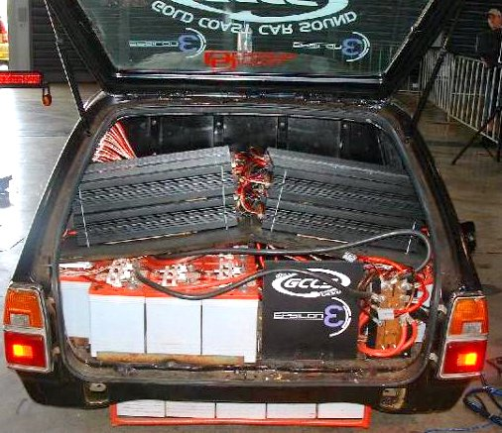

Slide 7
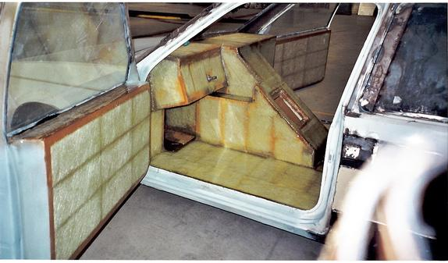

Slide 9
Mark 9:35
He sat down and summoned the Twelve. “So you want first place? Then take the last place. Be the servant of all.”

Slide 10
1. “So you want first place?”
A Selfless Missionary
Is Not Self-Serving

Slide 11
10 Dominant Behaviors of Inwardly-Focused Churches
Worship wars
Prolonged minutia meetings
Facility focus
Program driven

Slide 12
5. Inwardly focused budget
6. Inordinate demands for pastoral care
7. Attitudes of entitlement
8. Greater concern about change than the Gospel
9. Anger and Hostility
10. Evangelistic apathy

Slide 13
Philippians 2:3-4 (NRSV)
Do nothing from selfish ambition or conceit, but in humility regard others as better than yourselves. Let each of you look not to your own interests, but to the interests of others.

Slide 14
Philippians 2:5-6
Let the same mind be in you that was in Christ Jesus, who, though he was in the form of God, did not regard equality with God as something to be exploited…

Slide 15
"Blessed are those who can give without remembering,
and take without forgetting."
-- Elizabeth Bibesco, 1939

Slide 16
2.“Then take the last place.”
A Selfless Missionary
Is Self-Emptying

Slide 17
Philippians 2:7
…but emptied (kenosis) himself, taking the form of a slave, being born in human likeness.

Slide 18
Acts 11:22-26
When the church in Jerusalem got wind of this, they sent Barnabas to Antioch to check on things. As soon as he arrived, he saw that God was behind and in it all. He threw himself in with them, got behind them, urging them to stay with it the rest of their lives. He was a good man that way, enthusiastic and confident in the Holy Spirit’s ways…

Slide 19
…The community grew large and strong in the Master. Then Barnabas went on to Tarsus to look for Saul. He found him and brought him back to Antioch. They were there a whole year, meeting with the church and teaching a lot of people. It was in Antioch that the disciples were for the first time called Christians.

Slide 21
3. “Be the servant of all.”
A Selfless Missionary is
Self-Sacrificing

Slide 22
Philippians 2:8
And being found in human form,
he humbled himself
and became obedient to the point of death—
even death on a cross.

Slide 23
Mark 8:34-35
He called the crowd with his disciples, and said to them, “If any want to become my followers, let them deny themselves and take up their cross and follow me. For those who want to save their life will lose it, and those who lose their life for my sake, and for the sake of the gospel, will save it.

Slide 24
"To be crucified means, first, the man on the cross is facing only one direction; second, he is not going back; and third, he has no further plans of his own."
---A.W. Tozer

