Slide 1
NOTE: THE YOUTUBE VIDEO WILL BE PLAYED HERE… BEFORE ALL SLIDES!
THANKS!

Slide 2
At that moment the Spirit of the LORD came powerfully upon him, and he ripped the lion's jaws apart with his bare hands. He did it as easily as if it were a young goat.
Judges 14:6 NLT

Slide 3
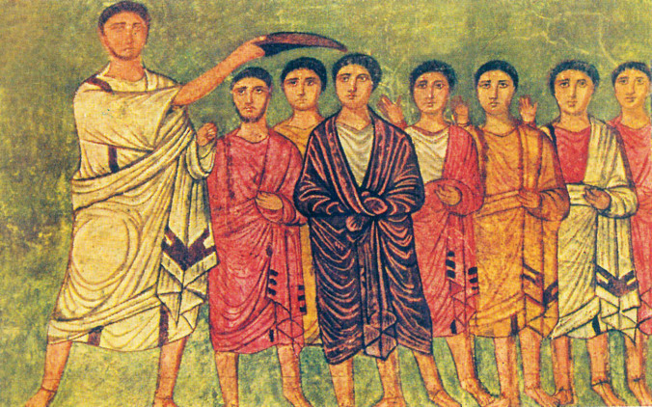
“So Samuel … anointed him in the midst of his brothers. And the Spirit of the Lord came mightily upon David from that day forward.” 1 Sam. 16:13

Slide 4
“Jesus began his public ministry by claiming for himself the messianic expectation in Isaiah 61:1 – “The Spirit of the Lord is on me, because he has anointed me to preach good news to the poor” (Luke 4:18) – which reveals his own consciousness of receiving “the Spirit without limit” (John 3:34). Jesus manifested the full range of gifts of the Spirit. His life beautifully demonstrated the gifts of knowledge, wisdom, faith, and healing as signs of the kingdom.”
Douglas Webster, A Passion for Christ

Slide 5
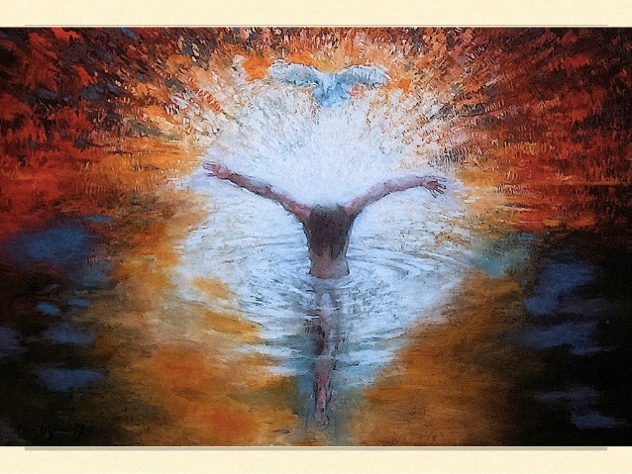

Slide 6
“(You know) how God anointed Jesus of Nazareth with the Holy Spirit and power, and how he went around doing good and healing all who were under the power of the devil, because God was with him.” Acts 10:38 NIV

Slide 7
“Precisely because the joy is set before us and we are empowered by the Holy Spirit, we are convinced that the example of Jesus is the practical pattern for the Christian life . . . The way to know Christ and to continue his ministry in the latter part of the twentieth century is to become like Jesus through the power of his Spirit.”
Webster, A Passion for Christ

Slide 8
Brookwood’s Guiding Verse for Missions
“But you will receive power when the Holy Spirit comes on you; and you will be my witnesses in Jerusalem, and in all Judea and Samaria, and to the ends of the Earth.”
Acts 1:8

Slide 9
Do we walk in the power of Spirit as Christ did?
Love the unlovable. Engage the marginalized.
Engage mainstream culture - Make fools of the wise – salt and light?
Heal and work miracles (Mission partners)
Surrender all – “Not my will, but yours, Father”
Unique in being raised from the dead in the power of the Spirit!
Energy, enthusiasm, focus, purpose
Transformation
Life-giving or life-taking

