Slide 2
James 1:19
Understand this, my dear brothers and sisters: You must all be quick to listen, slow to speak, and slow to get angry.

Slide 3
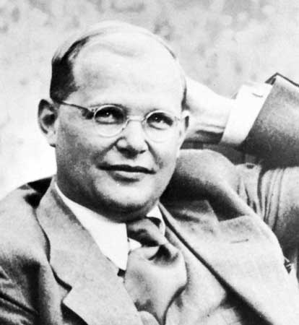

Slide 4
Good listening is a highest act of love.

Slide 5
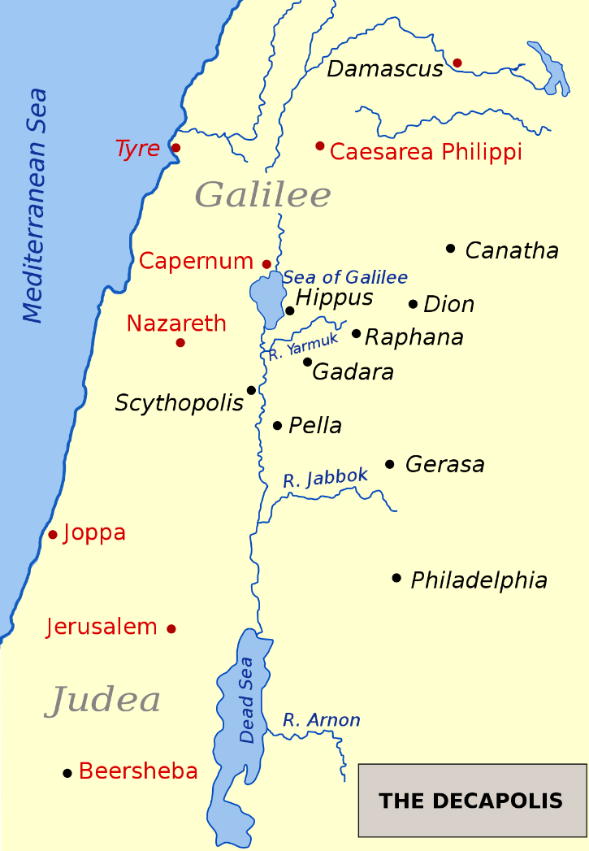

Slide 6
Mark 8:34-36
Then, calling the crowd to join his disciples, he said, “If any of you wants to be my follower, you must give up your own way, take up your cross, and follow me. If you try to hang on to your life, you will lose it. But if you give up your life for my sake and for the sake of the Good News, you will save it. And what do you benefit if you gain the whole world but lose your own soul?

Slide 7
“The first service that one owes to others in the fellowship consists in listening to them. Just as love to God begins with listening to His Word, so the beginning of love for the brethren is learning to listen to them. It is God’s love for us that He not only gives us His Word but also lends us His ear.”

Slide 9
2 Peter 3:18
Grow in the grace and knowledge of our Lord and Savior Jesus Christ. To him be glory both now and forever! Amen.

Slide 10
Philippians 2:3-4
Do nothing out of selfish ambition or vain conceit. Rather, in humility value others above yourselves, not looking to your own interests but each of you to the interests of the others.

Slide 11
“Just as love to God begins with listening to his Word, so the beginning of love for the brethren is learning to listen to them.”

Slide 12
Good listening is a highest act of patience.

Slide 14
Mark 9:35-39
Sitting down, Jesus called the Twelve and said, “Anyone who wants to be first must be the very last, and the servant of all.” He took a little child whom he placed among them. Taking the child in his arms, he said to them, “Whoever welcomes one of these little children in my name welcomes me; and whoever welcomes me does not welcome me but the one who sent me.”

Slide 15
Proverbs 18:2
Fools have no interest in understanding;
they only want to air their own opinions.

Slide 16
“One who cannot listen long and patiently will presently be talking beside the point and be never really speaking to others, albeit he be not conscious of it. Anyone who thinks that his time is too valuable to spend keeping quiet will eventually have no time for God and his brother, but only for himself and for his own follies.”

Slide 17
“Active Listening”
Externally relaxed
and
internally active

Slide 18
Good listening is a highest act of ministry.

Slide 20
Mark 10:41-45
When the ten other disciples heard what James and John had asked, they were indignant. So Jesus called them together and said, “You know that the rulers in this world lord it over their people, and officials flaunt their authority over those under them…

Slide 21
…But among you it will be different. Whoever wants to be a leader among you must be your servant, and whoever wants to be first among you must be the slave of everyone else. For even the Son of Man came not to be served but to serve others and to give his life as a ransom for many.”

Slide 22
“Often good listening involves putting more emphasis on affirmation than on answers. Many times God simply wants to use me as a channel of his affirming love as I listen with compassion and understanding…The best ministry you might do today is to listen to someone’s pain all the way to the bottom.”
--Janet Dunn, “How to Become a Good Listener”

Slide 23
We should listen with the ears of God that we may speak the word of God.

Slide 24
“He who can no longer listen to his brother will soon be no longer listening to God either; he will be doing nothing but prattle in the presence of God too. This is the beginning of the death of the spiritual life. . . . Anyone who thinks that his time is too valuable to spend keeping quiet will eventually have no time for God and his brother, but only for himself and for his own follies.”

Slide 25
John 7:5 -- …even his brothers didn’t believe in him.
Mark 3:21 -- When his family heard what was happening, they tried to take him away. “He’s out of his mind,” they said.

