Slide 2
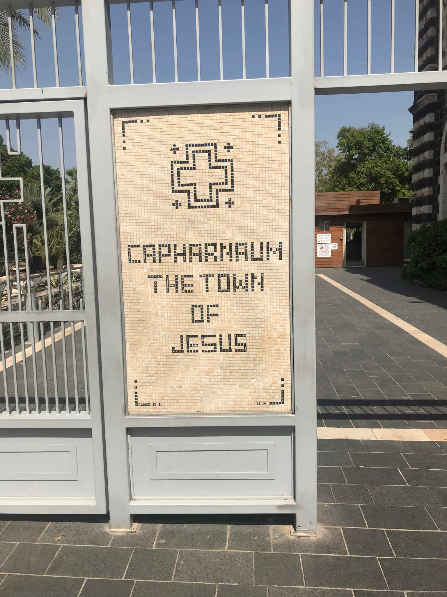

Slide 3
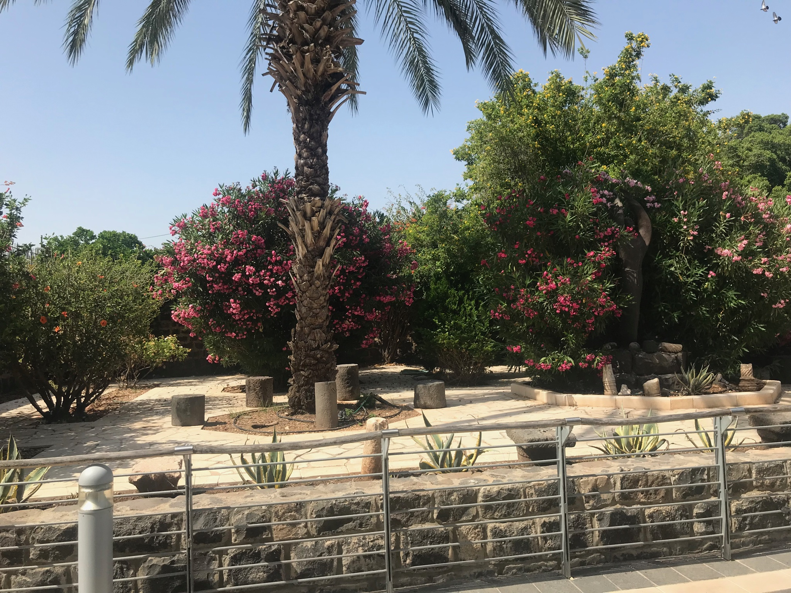

Slide 4
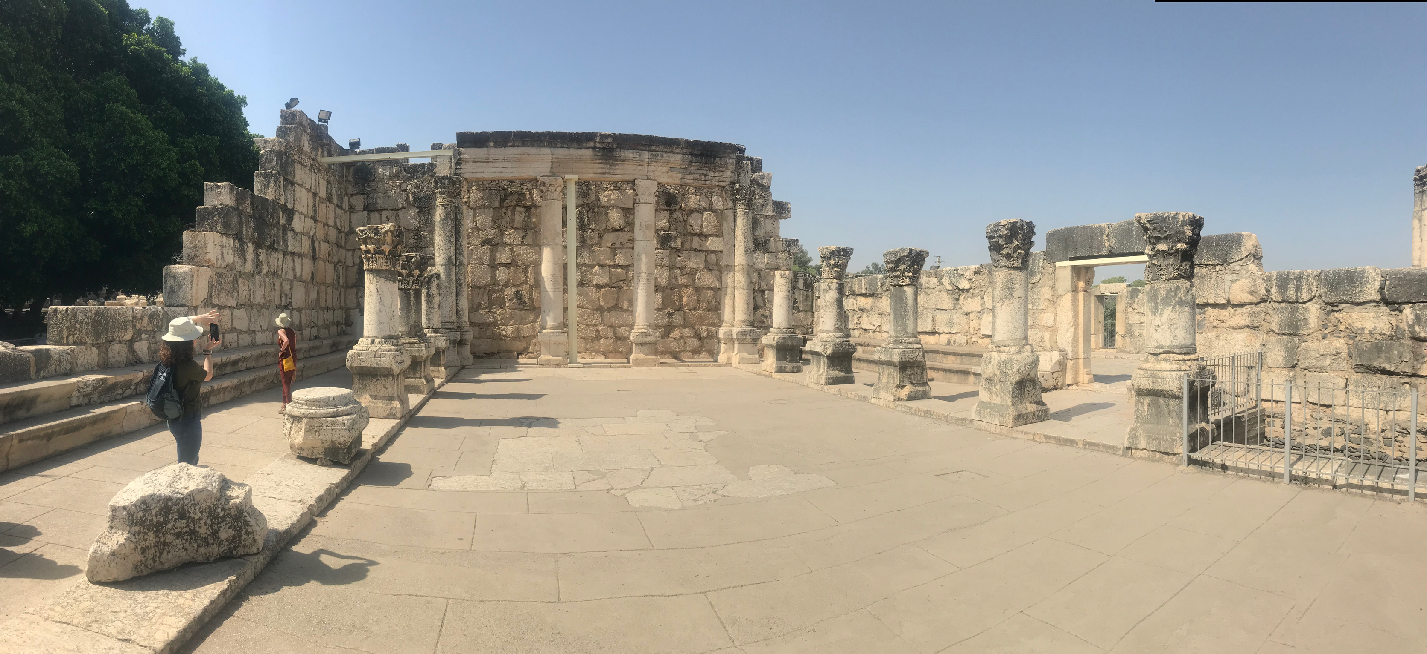

Slide 5
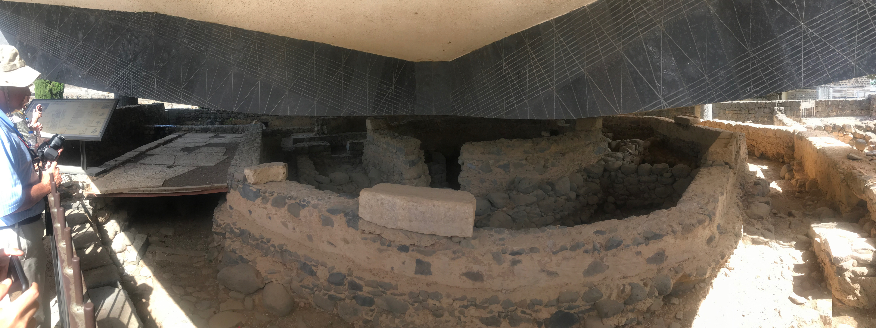

Slide 6
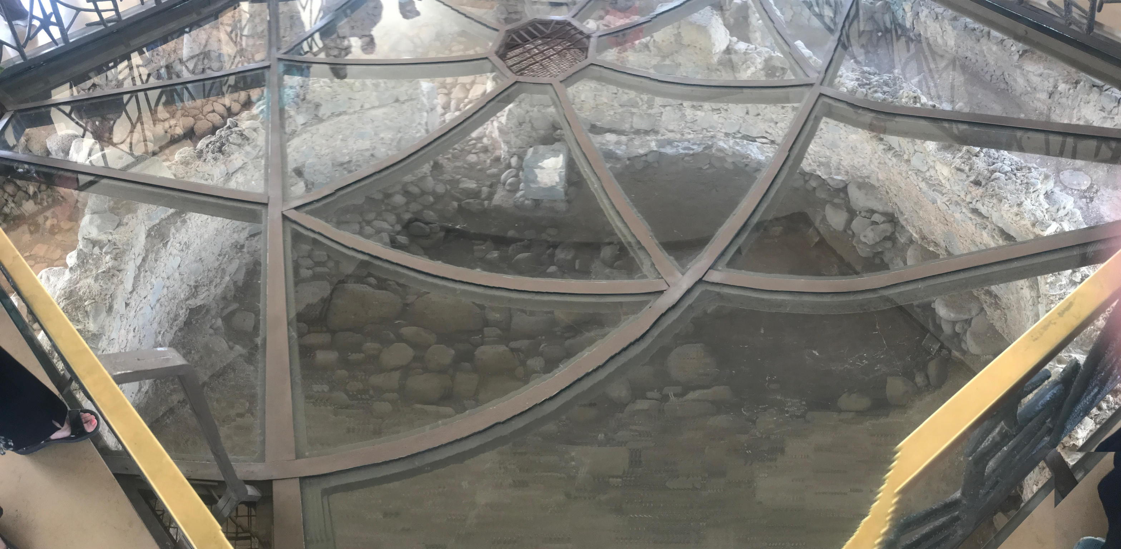

Slide 7
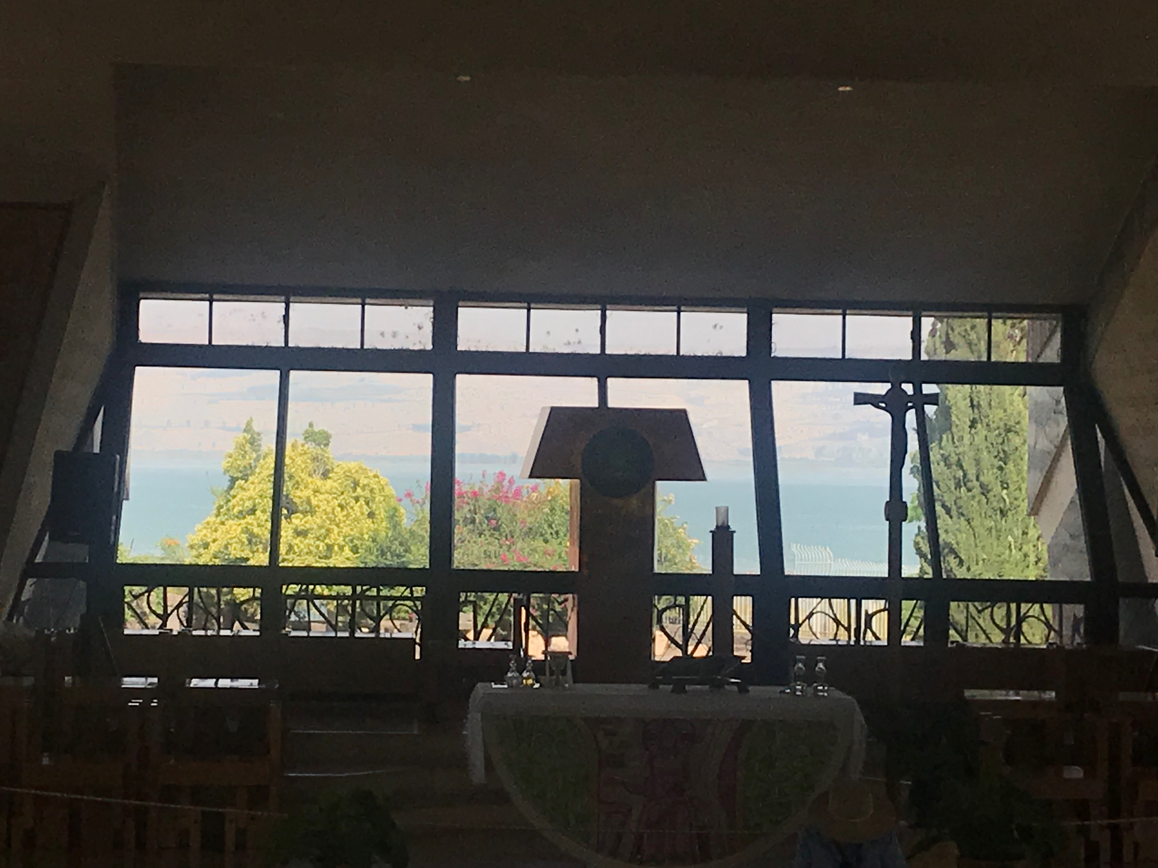

Slide 8
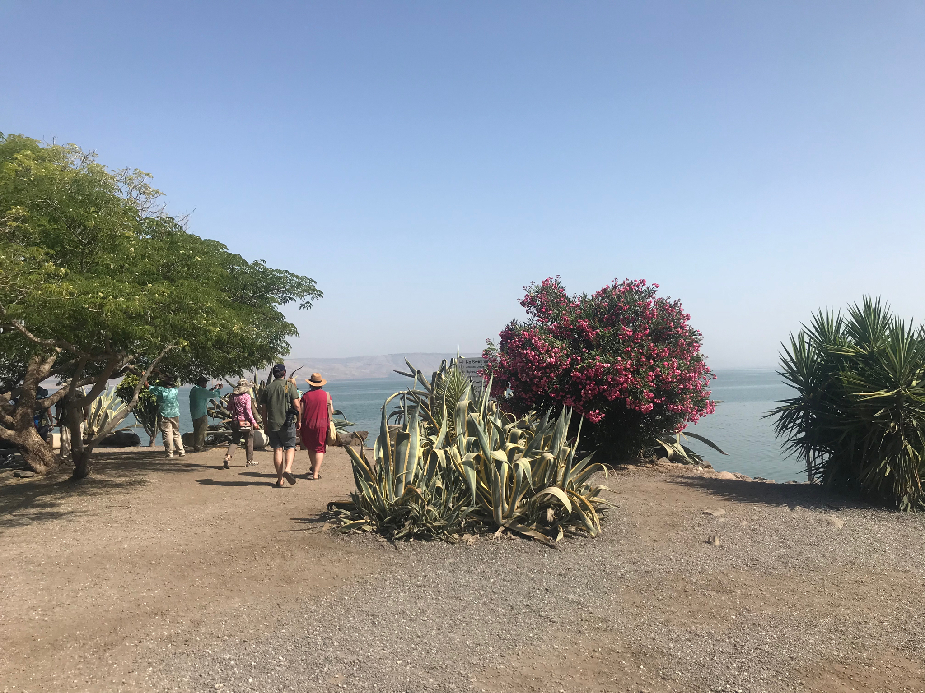

Slide 9
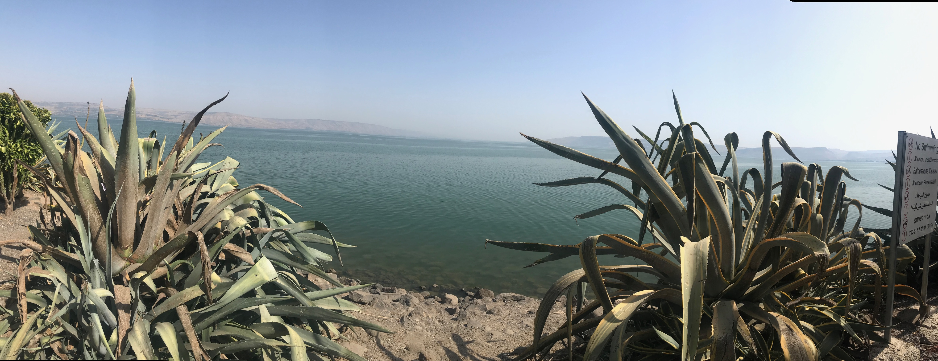

Slide 10
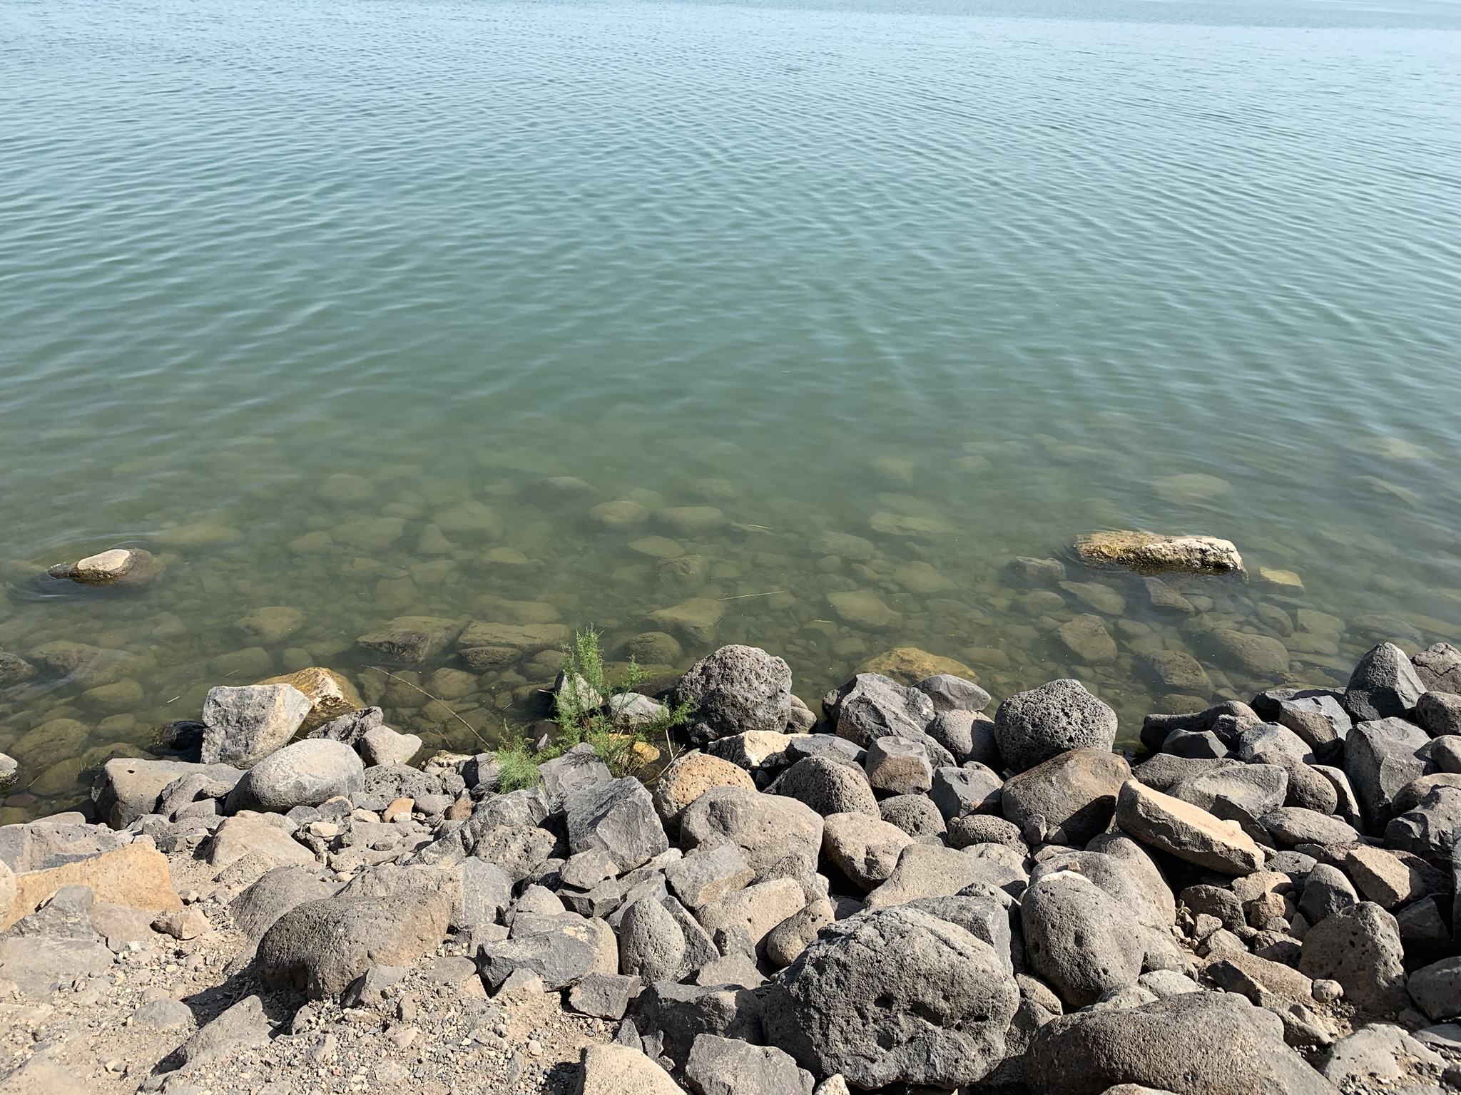

Slide 11
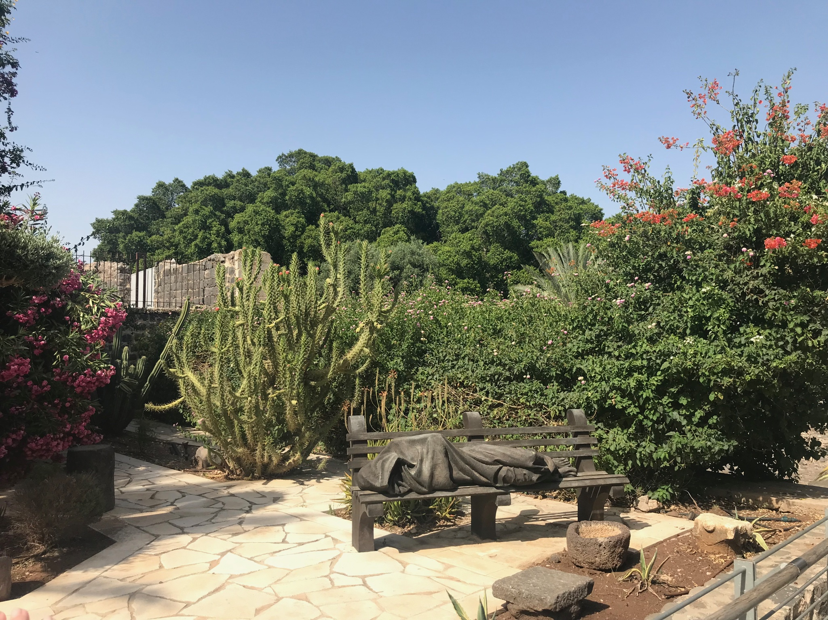

Slide 12
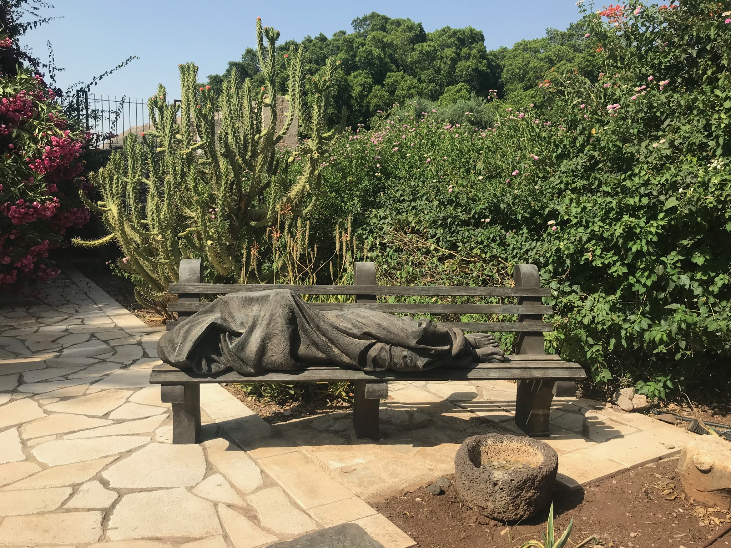

Slide 13
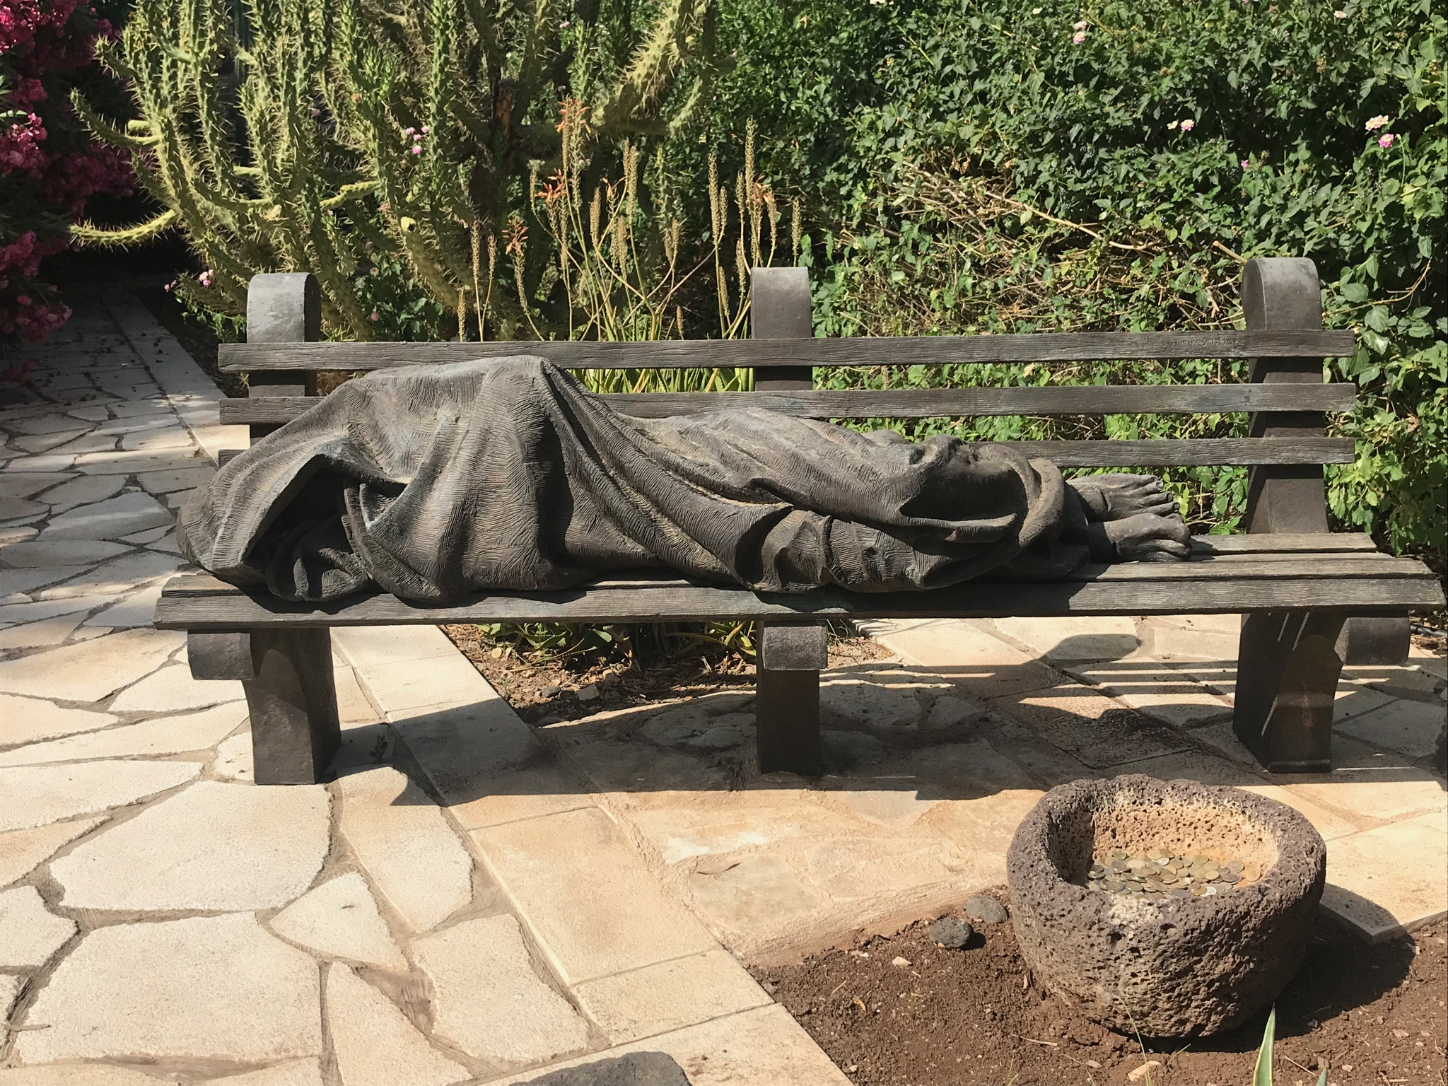

Slide 14
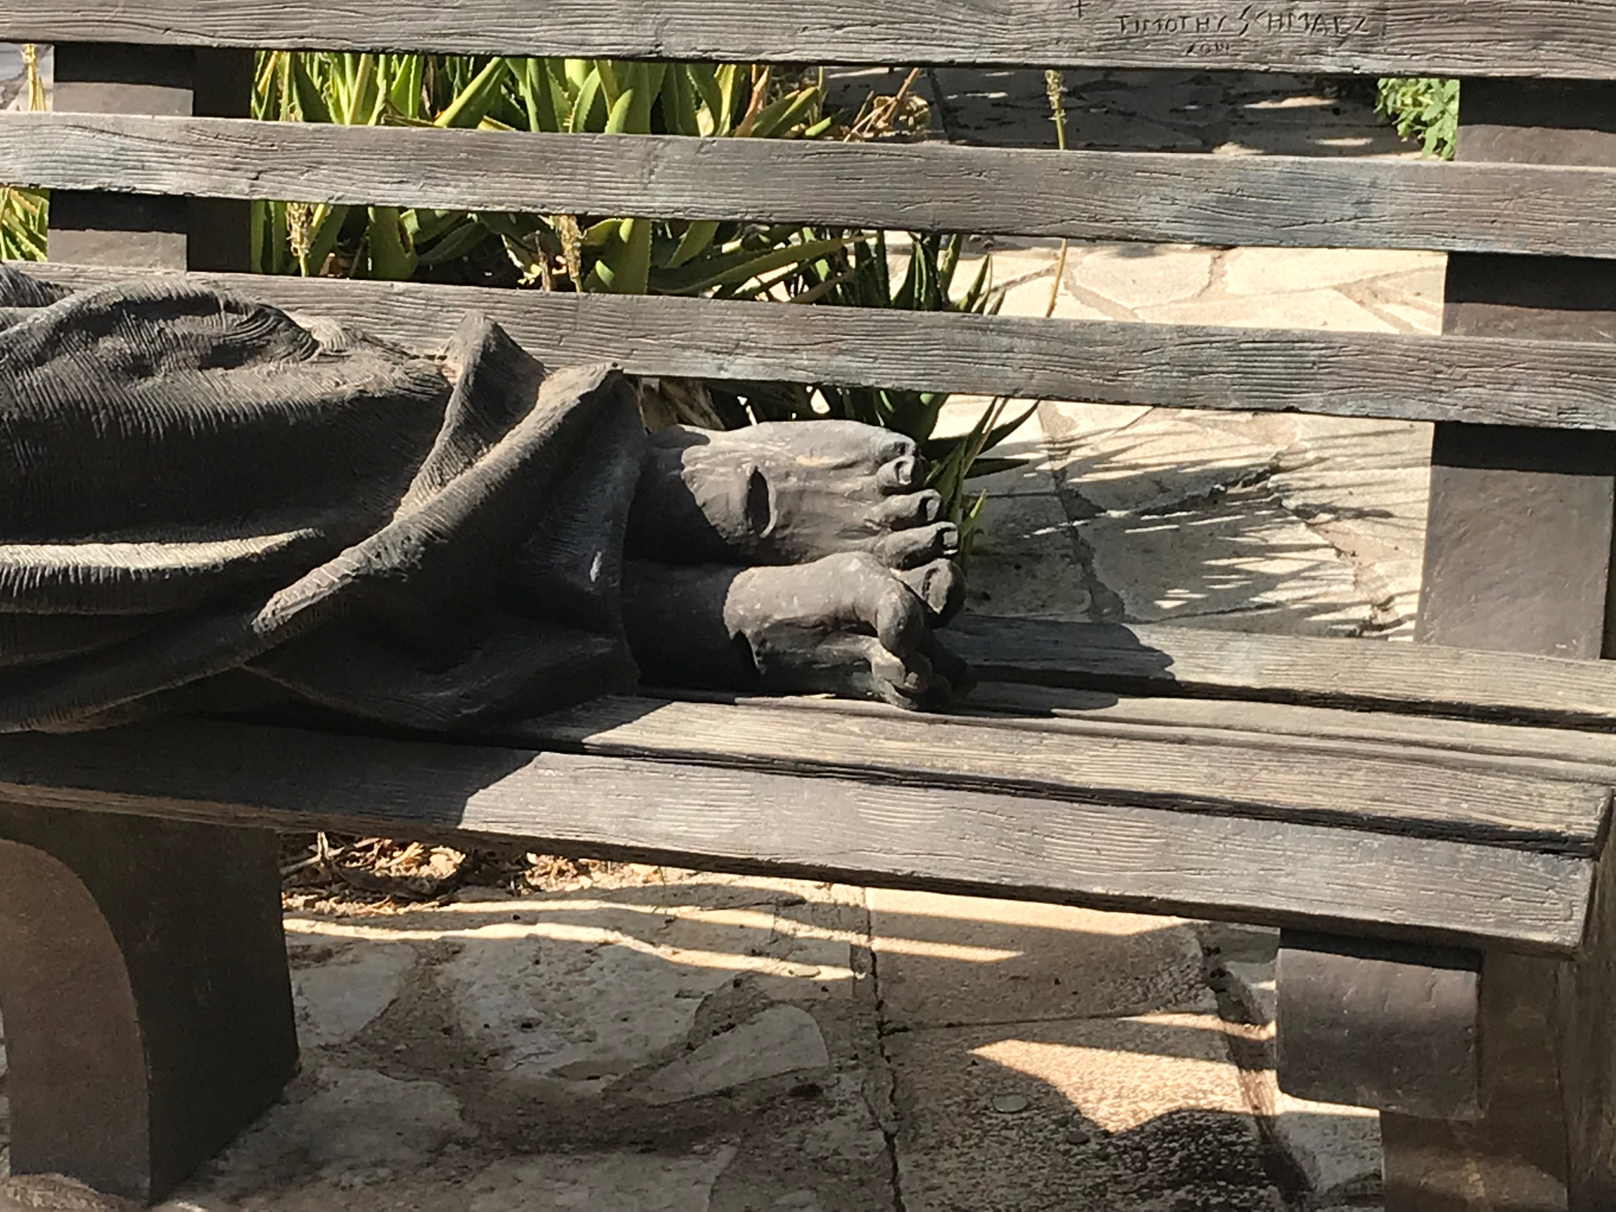

Slide 15
Mark 5:21
Jesus got into the boat again and went back to the other side of the lake, where a large crowd gathered around him on the shore.

Slide 16
Verses 22-23
Then a leader of the local synagogue, whose name was Jairus, arrived. When he saw Jesus, he fell at his feet, pleading fervently with him. “My little daughter is dying,” he said. “Please come and lay your hands on her; heal her so she can live.”

Slide 17
Verses 30-32
…He turned around in the crowd and asked, “Who touched my robe?”
His disciples said to him, “Look at this crowd pressing around you. How can you ask, ‘Who touched me?’”
But he kept on looking around to see who had done it.

Slide 18
Verses 33-34
Then the frightened woman, trembling at the realization of what had happened to her, came and fell to her knees in front of him and told him what she had done. And he said to her, “Daughter, your faith has made you well. Go in peace. Your suffering is over.”

