Slide 3
Scandalous Math

Slide 4
Scandalous God

Slide 5
Verses 13-15
“He answered one of them, ‘Friend, I haven’t been unfair! Didn’t you agree to work all day for the usual wage? Take your money and go. I wanted to pay this last worker the same as you. Is it against the law for me to do what I want with my money? Should you be jealous because I am kind to others?’

Slide 6
Scandalous Church

Slide 7
Verses 6-7
“At five o’clock that afternoon he was in town again and saw some more people standing around. He asked them, ‘Why haven’t you been working today?’
“They replied, ‘Because no one hired us.’

Slide 8
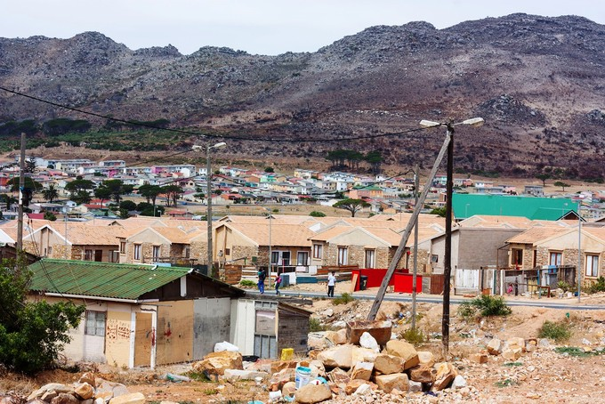

Slide 9
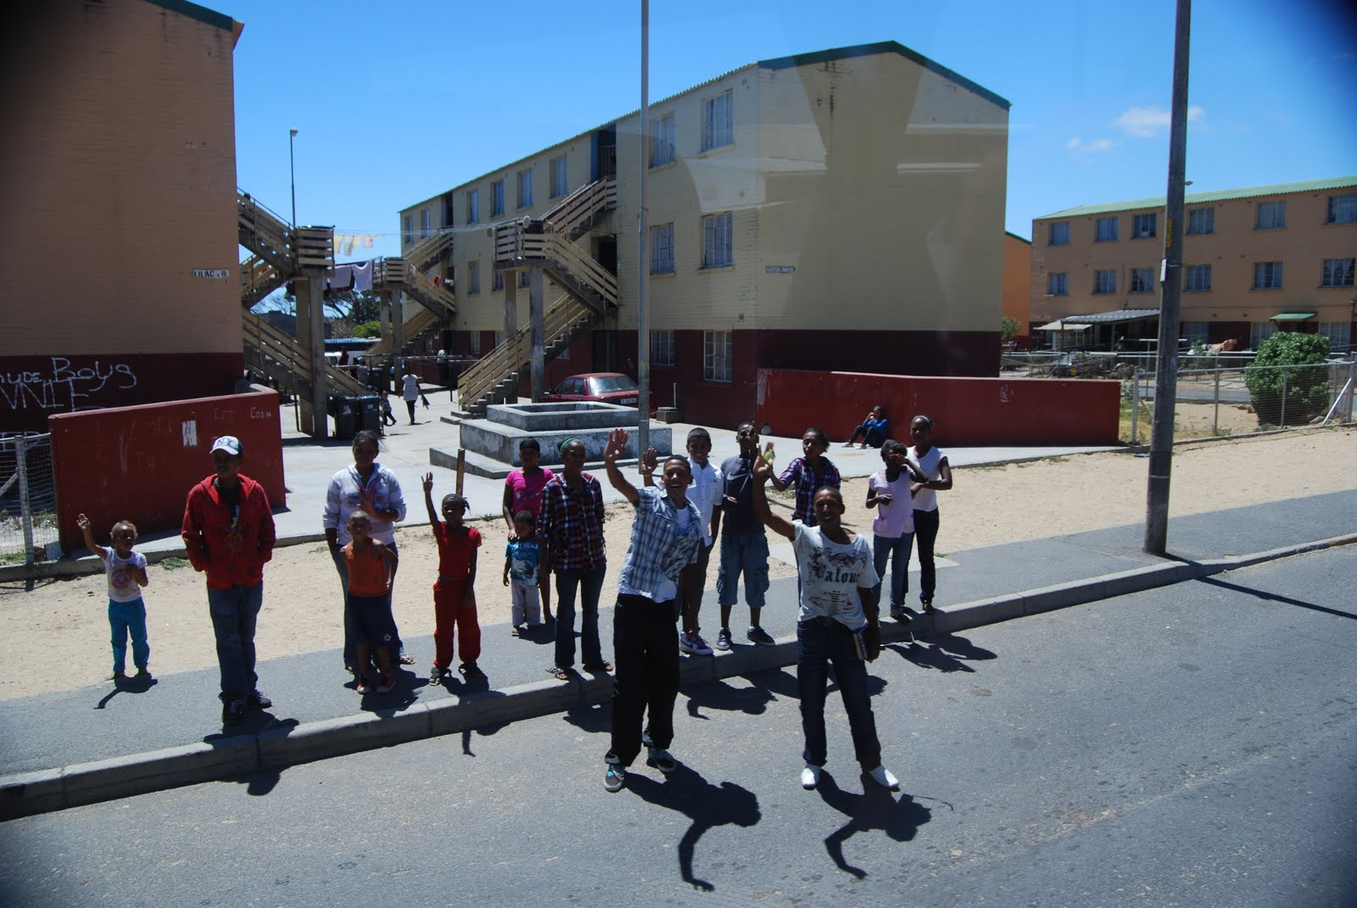

Slide 12
Americans most like to hear…
“I love you.”
“I forgive you.”
“Supper’s ready.”

