Slide 2


Slide 3


Slide 4
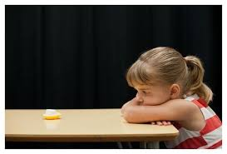

Slide 5


Slide 6
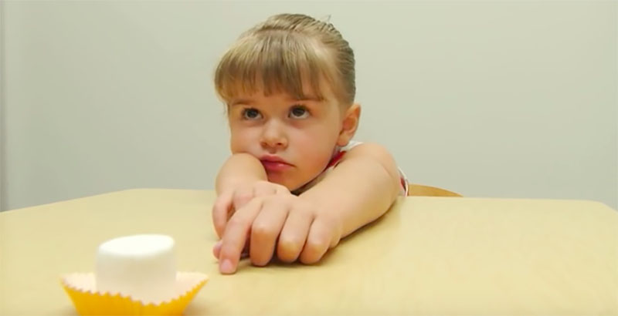

Slide 7
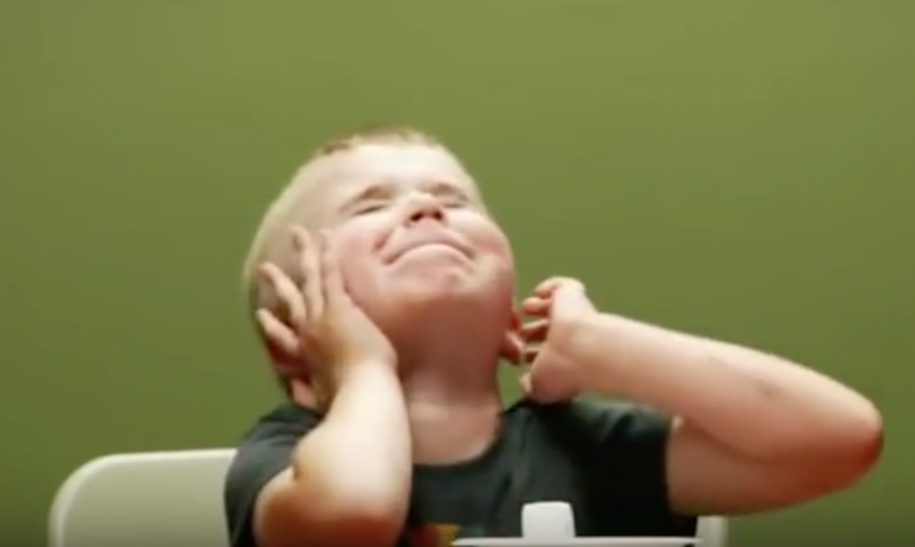

Slide 9
Isaiah 40:31
Those who wait for the Lord shall renew their strength,
they shall mount up with wings
like eagles,
they shall run and not be weary,
they shall walk and not faint.

Slide 10
Psalm 33:20-21
We wait in hope for the Lord;
he is our help and our shield.
In him our hearts rejoice,
for we trust in his holy name.

Slide 11
Psalm 130:5-7
I wait for the Lord, my whole being waits,
and in his word I put my hope.
I wait for the Lord
more than watchmen wait for the morning.
Israel, put your hope in the Lord,
for with the Lord is unfailing love
and with him is full redemption.

Slide 13
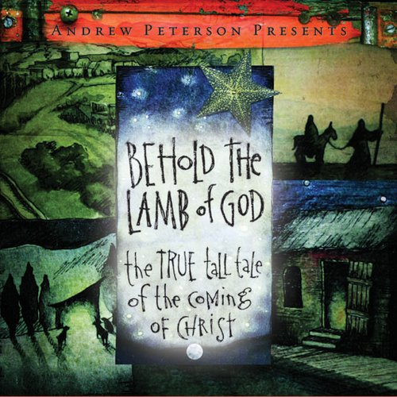

Slide 15
Hebrews 12:2
Let us run with perseverance the race marked out for us, fixing our eyes on Jesus, the pioneer and perfecter of faith. For the joy set before him he endured the cross, scorning its shame, and sat down at the right hand of the throne of God.

Slide 16
