Slide 1
Acts 10
Peter’s New Kingdom Vision:
The next day as Cornelius’ messengers were nearing the town, Peter went up on the flat to pray. It was about noon, and he was hungry. But while a meal was being prepared, he fell into a trance. He saw the sky open, and something like a large sheet was let down by its four corners. In the sheet were all sorts of animals, reptiles, and birds. Then a voice said to him, “Get up, Peter; kill and eat them.”
“No, Lord,” Peter declared. “I have never eaten anything that our Jewish laws have declared impure and unclean.”
But the voice spoke again: “Do not call something unclean if God has made it clean.” The same vision was repeated three times. Then the sheet was suddenly pulled up to heaven” (vv. 9-16).

Slide 2
Cornelius and the Gentiles Accept Peter’s Message:
Peter told them, “You know it is against our laws for a Jewish man to enter a Gentile home like this or associate with you. But God has shown me that I should no longer think of anyone as impure or unclean. So I came without objection as soon as I was sent for. Now tell me why you sent for me” (vv. 28-29).
Then Peter replied, “I see very clearly that God shows no favoritism. In every nation he accepts those who fear him and do what is right. This is the message of Good News for the people of Israel- that there is peace with God through Jesus Christ, who is Lord of all” (vv. 34-36).
Even as Peter was saying these things, the Holy Spirit fell upon all who were listening to the message. The Jewish believers who came with Peter were amazed that the gift of the Holy Spirit had been poured out on the Gentiles too (vv. 44-45) (NLT).

Slide 3
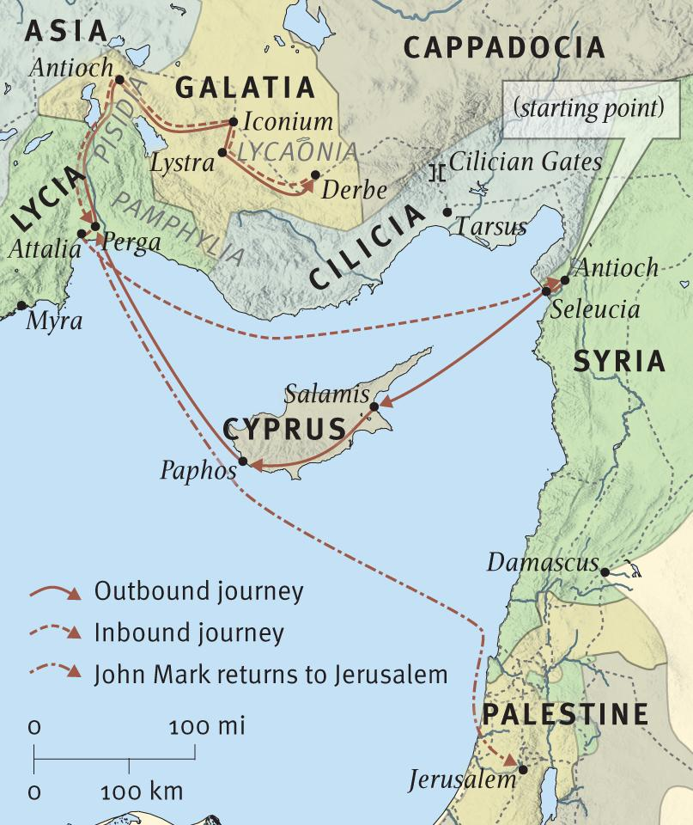

Slide 4
Josephus
Antiochene Culture:
The Jewish race, densely interspersed among the native populations of every portion of the world, is particularly numerous in Syria, where intermingling is due to the proximity of the two countries. But it was at Antioch that they especially congregated…Moreover, they were constantly attracting to their religious ceremonies multitudes of Greeks, and these they had in some measure incorporated with themselves (The Jewish War, 7.43, 45).

Slide 5
Acts 15
James’ Position:
“And so my judgment is that we should not make it difficult for the Gentiles who are turning to God. Instead, we should write and tell them to abstain from eating food offered to idols, from sexual immorality, from eating the meat of strangled animals, and from consuming blood. For these laws of Moses have been preached in Jewish synagogues in every city on every Sabbath for many generations” (vv. 19-21).
Council Letter to Antioch:
“For it seemed good to the Holy Spirit and to us to lay no greater burden on you than these few requirements: You must abstain from eating food sacrificed to idols, from consuming the blood or the meat of strangled animals, and from sexual immorality. If you do this, you will do well. Farewell” (vv. 28-29) (NLT)

Slide 6
Galatians 1
This letter is from Paul, an apostle. I was not anointed by any group of people or any human authority, but by Jesus Christ himself and by God the Father, who raised Jesus from the dead (v. 1) (NLT)

Slide 7
Acts 11
When the church at Jerusalem heard what had happened, they sent Barnabas to Antioch. When he arrived and saw the evidence of God’s blessing, he was filled with joy, and he encouraged the believers to stay true to the Lord. Barnabas was a good man, full of the Holy Spirit and strong in faith. And many people were brought to the Lord (vv. 23-24) (NLT).

Slide 8
Galatians 5
But the Holy Spirit produces this kind of fruit in our lives: LOVE, JOY, PEACE, PATIENCE, KINDNESS, GOODNESS, FAITHFULNESS, GENTLENESS, and SELF-CONTROL. There is no law against these things! (vv. 22-23) (NLT).

Slide 9
2 Peter 3
And so, dear friends, while you are waiting for these things to happen, make every effort to be found living peaceful lives that are pure and blameless in his sight. And remember, the Lord’s patience gives people time to be saved. This is what our beloved brother Paul also wrote to you with the wisdom God gave him (vv. 14-15) (NLT)

