Slide 2
Look Up
Look Down
Look Back
Look Forward

Slide 3
Look up to the heavens!

Slide 4
Psalm 8:1
O Lord, our Lord, your majestic name fills the earth! Your glory is higher than the heavens.

Slide 6
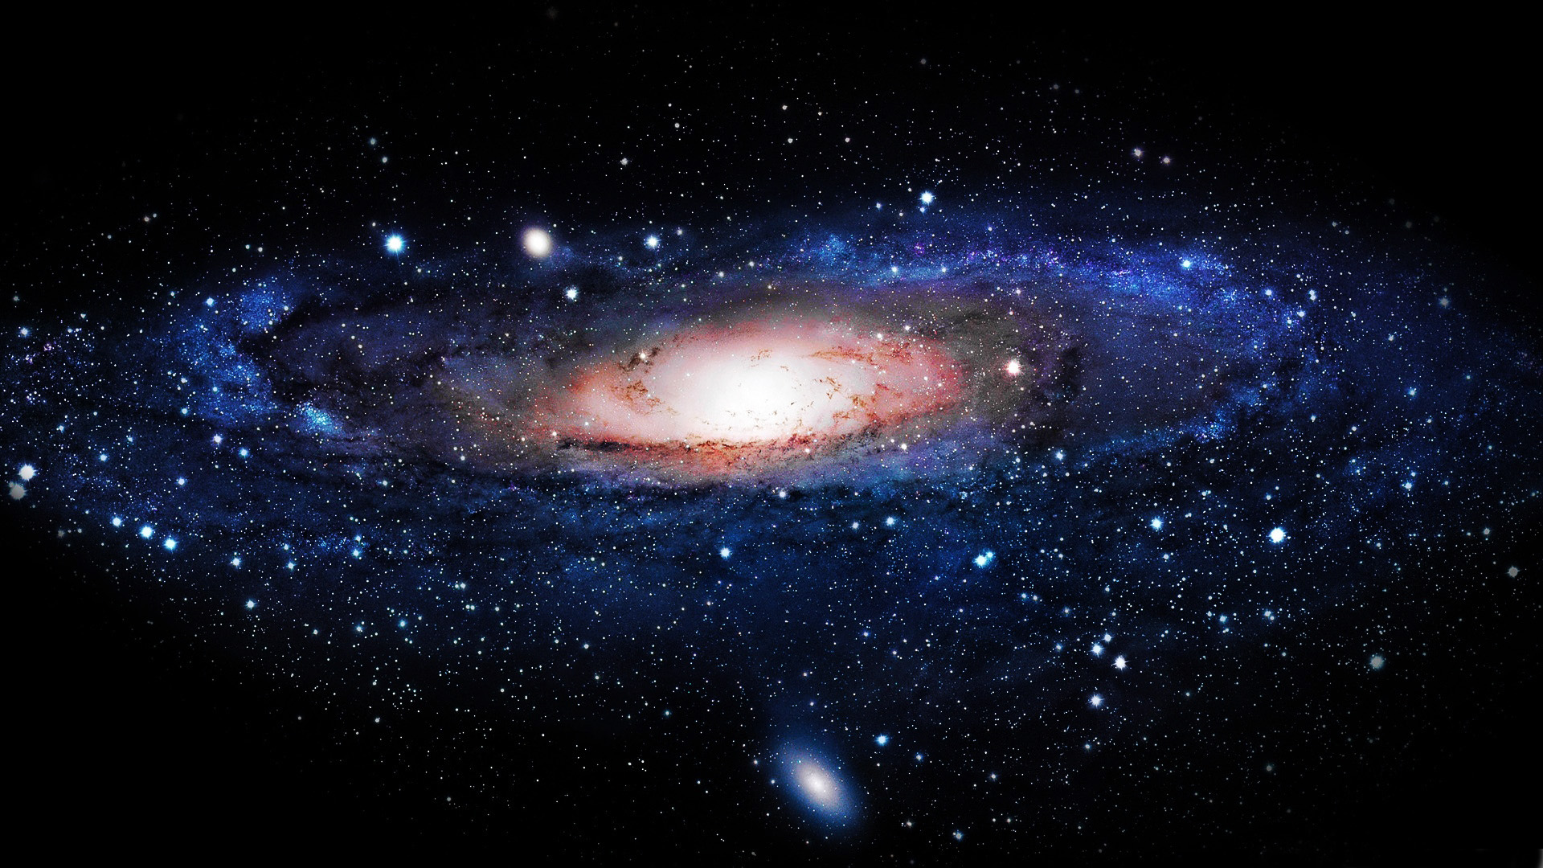

Slide 7
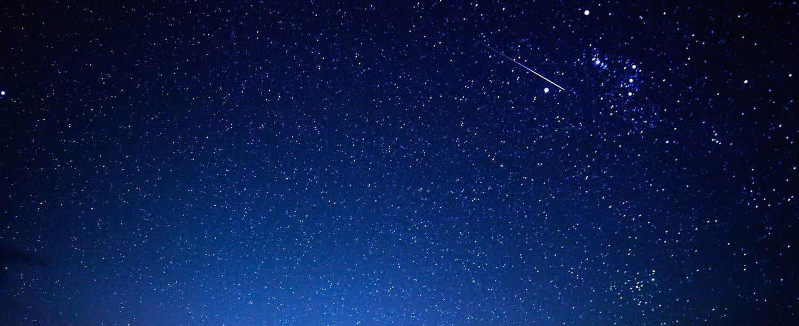

Slide 8
Look down to yourself!

Slide 9
Psalm 1:2
You have taught children and infants
to tell of your strength,
silencing your enemies
and all who oppose you.

Slide 10
Matthew 21:15-16
The leading priests and the teachers of religious law saw these wonderful miracles and heard even the children in the Temple shouting, “Praise God for the Son of David.” But the leaders were indignant. They asked Jesus, “Do you hear what these children are saying?” “Yes,” Jesus replied. “Haven’t you ever read the Scriptures? For they say, ‘You have taught children and infants to give you praise.’”

Slide 11
Look up at His grand production!

Slide 12
Psalm 8:3
When I look at the night sky and see the work of your fingers—the moon and the stars you set in place…

Slide 13
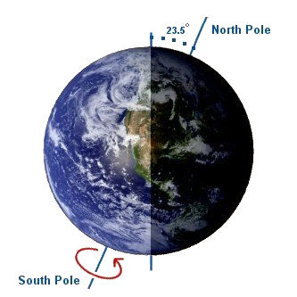

Slide 14
Look down at your grand position!

Slide 15
Psalm 8:4-5
…what are mere mortals that you should think about them, human beings that you should care for them? Yet you made them only a little lower than God and crowned them with glory and honor.

Slide 16
Look back at what He did with us!

Slide 17
Psalm 8:6-8
You gave them charge of everything you made, putting all things under their authority— the flocks and the herds and all the wild animals, the birds in the sky, the fish in the sea, and everything that swims the ocean currents.

Slide 18
Look back at what we did with us!

Slide 19
Genesis 3:4-6
You won’t die!” the serpent replied to the woman. “God knows that your eyes will be opened as soon as you eat it, and you will be like God…

Slide 20
Look back at what He did for us!

Slide 21
Romans 5:6-11
When we were utterly helpless, Christ came at just the right time and died for us sinners. Now, most people would not be willing to die for an upright person, though someone might perhaps be willing to die for a person who is especially good…

Slide 22
…But God showed his great love for us by sending Christ to die for us while we were still sinners. And since we have been made right in God’s sight by the blood of Christ, he will certainly save us from God’s condemnation.

Slide 23
For since our friendship with God was restored by the death of his Son while we were still his enemies, we will certainly be saved through the life of his Son. So now we can rejoice in our wonderful new relationship with God because our Lord Jesus Christ has made us friends of God.

Slide 24
Look forward at what Christ will do for us!

Slide 25
Revelation 3:20-21
“Look! I stand at the door and knock. If you hear my voice and open the door, I will come in, and we will share a meal together as friends. Those who are victorious will sit with me on my throne, just as I was victorious and sat with my Father on his throne.

Slide 26
Psalm 8:9
“O Lord, our Lord, your majestic name fills the earth!”

