Slide 2
The Life of Peter: A Summary in Picture

Slide 3
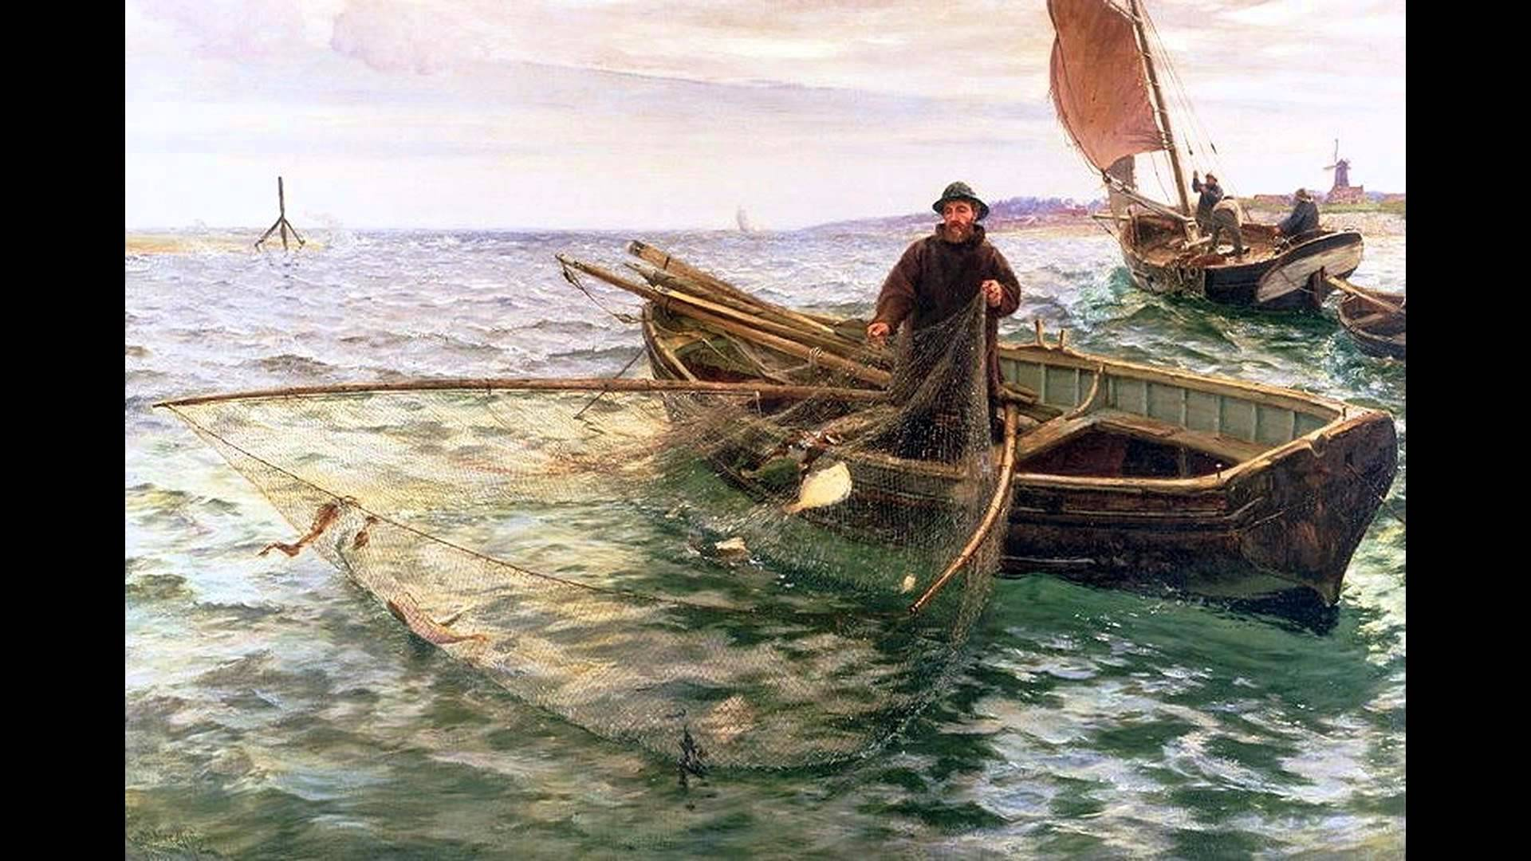

Slide 8
VIDEO CLIP OF PETER’S DENIAL WILL BE PLAYED HERE

Slide 14
I Peter – Hear the evolution of the rock
Therefore, prepare your minds for action; be self-controlled; set your hope fully on the grace to be given you when Jesus Christ is revealed. 1:13
Be holy in all you do. 1:15

Slide 15
Dear friends, I urge you, as aliens and strangers in the world, to abstain from sinful desires, which war against your soul. Live such good lives among the pagans that, though they accuse you of doing wrong, they may see your good deeds and glorify God on the day he visits us. 2:11-12 (Mtw. 5:16)
To this you were called, because Christ suffered for you, leaving you an example, that you should follow in his steps. 2:21

Slide 16
Finally, all of you, live in harmony with one another; be sympathetic, love as brothers, be compassionate and humble. Do not repay evil with evil or insult with insult, but with blessing… (we) must turn from evil and do good; seek peace and pursue it… 3:8f

Slide 17
The end of all things is near. Therefore be clear minded and self-controlled so that you can pray. Above all, love each other deeply, because love covers over a multitude of sins. Offer hospitality to one another without grumbling…serve with the strength God provides so that in all things God may be praised through Jesus Christ. 4:7f

Slide 18
Be eager to serve; not lording it over those entrusted to you, but being examples to the flock. 5:2-3
Humble yourselves, therefore, under God’s mighty hand, that he may lift you up in due time. Cast all your anxiety on him because he cares for you. Be self-controlled and alert. Your enemy prowls around like a roaring lion looking for someone to devour. Resist him, standing firm in the faith, because you know that your brothers throughout the world are undergoing the same kind of sufferings. 5:6-9

Slide 19
Worship Question
How is God changing you?

