Slide 2
Translating Mark
for the Majera
Verses sold: 559
Chapters completed: 10
Remaining verses: 119
$25 per verse – As you leave!

Slide 3
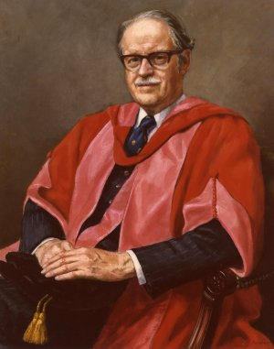
“Men and women disbelieve the Easter story not because of the evidence, but in spite of it. To spurn the evidence is to spite one’s self.”

Slide 4
“The Empty Christ
and the Empty Tomb”
Destination: Jesus emptied Himself so that we can celebrate the empty tomb.

Slide 5
5 In your relationships with one another, have the same mindset as Christ Jesus:
6 Who, being in very nature God,
did not consider equality with God something to be used to his own advantage;

Slide 6
7 rather, he emptied himself,
taking the very nature of a servant,
being made in human likeness.
8 And being found in appearance as a man
he humbled himself
by becoming obedient to death—
even death on a cross!

Slide 7
9 Therefore God exalted him to the highest place
and gave him the name that is above every name,
10 that at the name of Jesus every knee should bow, in heaven and on earth and under the earth,
11 and every tongue confess that Jesus Christ is Lord, to the glory of God the Father.

Slide 8
He was tempted to
use His divinity for Himself.

Slide 9
Mark 1:12-13
The Spirit then compelled Jesus to go into the wilderness, where he was tempted by Satan for forty days.

Slide 10
Mark 1:9-11
One day Jesus came from Nazareth in Galilee, and John baptized him in the Jordan River. As Jesus came up out of the water, he saw the heavens splitting apart and the Holy Spirit descending on him like a dove. And a voice from heaven said, “You are my dearly loved Son, and you bring me great joy.”

Slide 12
The Temptation =
A shortcut to Kingship!

Slide 13
2. Instead, He emptied Himself for us.

Slide 14
Philippians 1:6 (NIV)
Who, being in very nature God,
did not consider equality with God something to be used to his own advantage;

Slide 15
Philippians 1:6 (NRSV)
who, though he was in the form of God,
did not regard equality with God
as something to be exploited…

Slide 16
Verse 7
…but emptied himself,
taking the form of a slave,
being born in human likeness.
And being found in human form…

Slide 17
Verses 6-7 (J.B. Phillips New Testament)
For he, who had always been God by nature, did not cling to his prerogatives as God’s equal, but stripped himself of all privilege by consenting to be a slave by nature and being born as mortal man.

Slide 18
3. By His self-emptying,
He left an empty tomb.

Slide 19
Mark 16:5-7
When they entered the tomb, they saw a young man clothed in a white robe sitting on the right side. The women were shocked, but the angel said, “Don’t be alarmed. You are looking for Jesus of Nazareth, who was crucified. He isn’t here! He is risen from the dead! Look, this is where they laid his body. Now go and tell his disciples, including Peter, that Jesus is going ahead of you to Galilee. You will see him there, just as he told you before he died.”

