Slide 2
Psalm 107: 8, 15, 21, 31
Let them praise the Lord
for his great love
and for the wonderful things he has done for them.

Slide 4
Psalm 107: 8, 15, 21, 31
Let them praise the Lord
for his great love
and for the wonderful things he has done for them.

Slide 5
3-Picture Gallery
Travelers who are lost
Prisoners who are trapped
Sailors sinking in a storm

Slide 6
Remember Him
Thank Him
Trust Him

Slide 7
Thank God for being there when you were directionless.

Slide 8
Verses 4-9
Some wandered in the wilderness,
lost and homeless.
Hungry and thirsty,
they nearly died.
“Lord, help!” they cried in their trouble,
and he rescued them from their
distress…

Slide 9
…He led them straight to safety,
to a city where they could live.
Let them praise the Lord for his great love and for the wonderful things he has done for them.
For he satisfies the thirsty
and fills the hungry with good things.

Slide 10
Remember Him
Thank Him
Trust Him

Slide 11
My Lord God, I have no idea where I am going.
I do not see the road ahead of me.
I cannot know for certain where it will end. Nor do I really know myself, and the fact that I think I am following your will does not mean that I am actually doing so.

Slide 12
But I believe that the desire to please you does in fact please you.
And I hope I have that desire in all that I am doing.
I hope that I will never do anything apart from that desire. And I know that if I do this you will lead me by the right road, though I may know nothing about it.

Slide 13
Therefore I will trust you always though I may seem to be lost and in the shadow of death. I will not fear, for you are ever with me, and you will never leave me to face my perils alone.

Slide 14
Thank God for being there when you were foolish.

Slide 15
Verses 10-16
Some sat in darkness and deepest gloom,
imprisoned in iron chains of misery.
They rebelled against the words of God,
scorning the counsel of the Most High.
They fell, and no one was there to help them…

Slide 16
“Lord, help!” they cried in their trouble,
and he saved them from their distress.
He led them from the darkness and deepest gloom;
he snapped their chains.
..he broke down their prison gates of bronze; he cut apart their bars of iron.

Slide 17


Slide 18
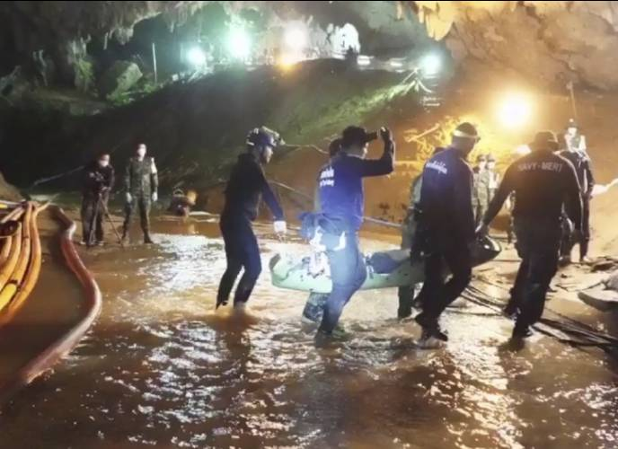

Slide 19
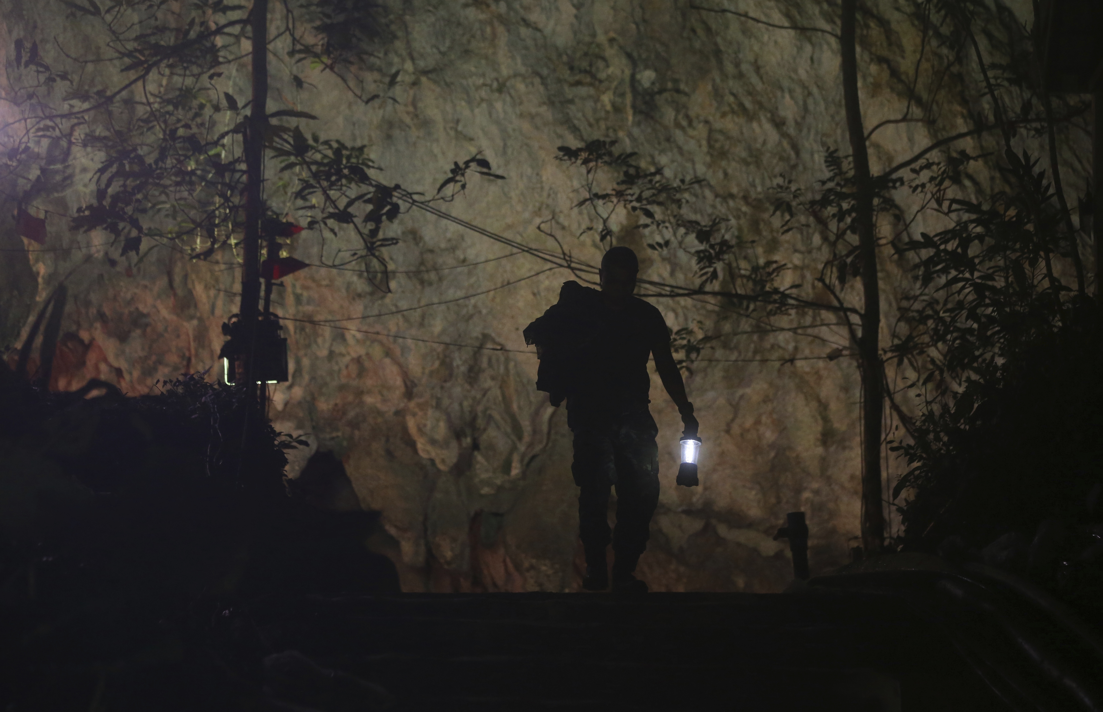

Slide 21
Remember Him
Thank Him
Trust Him

Slide 22
Thank God for being there when you were powerless.

Slide 23
Their ships were tossed to the heavens
and plunged again to the depths;
the sailors cringed in terror.
They reeled and staggered like drunkards
and were at their wits’ end.
“Lord, help!” they cried in their trouble,
and he saved them from their distress...

Slide 24
He calmed the storm to a whisper and stilled the waves.
What a blessing was that stillness as he brought them safely into harbor!

Slide 25
Verses 13, 19, 28
“Lord, help!” they cried in their trouble,
and he saved them from their distress.

Slide 26
James 1:6
But when you ask him, be sure that your faith is in God alone. Do not waver, for a person with divided loyalty is as unsettled as a wave of the sea that is blown and tossed by the wind.

Slide 27
Psalm 94:18-19
I cried out, “I am slipping!”
but your unfailing love, O Lord, supported me.
When doubts filled my mind,
your comfort gave me renewed hope and cheer.

Slide 28


Slide 29


Slide 30
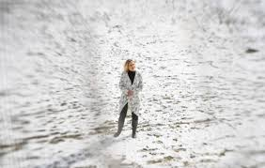

Slide 31
Remember Him
Thank Him
Trust Him

