Slide 2
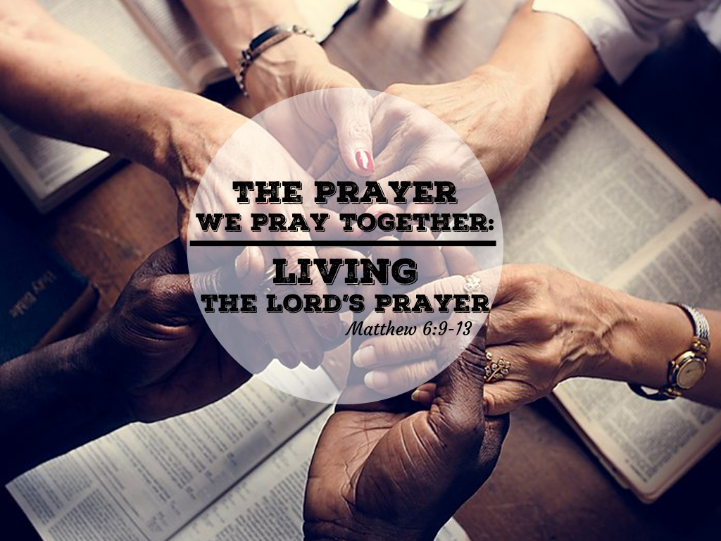

Slide 3
Thy will

Slide 4
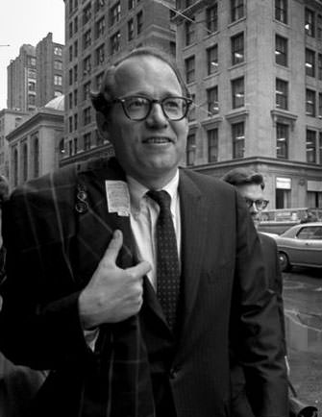

Slide 6
Thy will be done

Slide 7
3 Keys to Doing God’s Will
Commit yourself to doing God’s will.
Make the best decision you can.
Trust God to guide you.

Slide 8
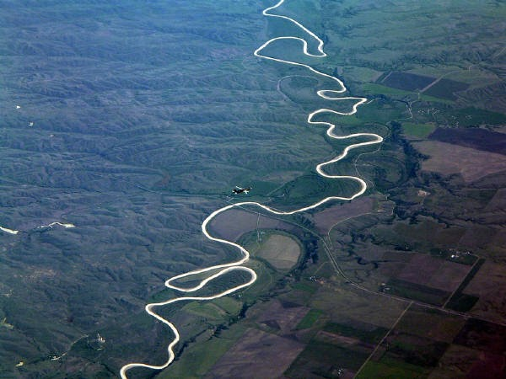

Slide 9
Thy will be done
on earth
as it is in heaven

Slide 10


Slide 11
“Jesus was that unique event by which not only the word of God
was made flesh, but the will of God was made flesh as well.”
-- William E. Hull

Slide 12
“The Lord’s Prayer
is ‘Jesus-specific.’”
--N.T. Wright

Slide 13
"There are two kinds of people: those who say to God, 'Thy will be done,' and those to whom God says, 'All right, then, have it your way.’”
-- C.S. Lewis

