Slide 2
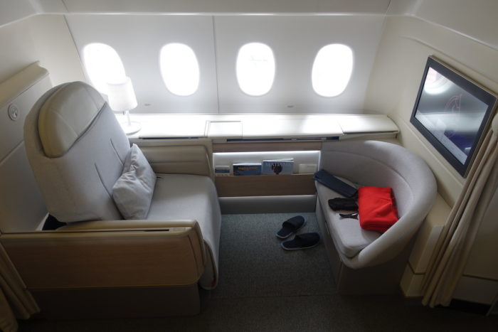

Slide 3


Slide 4
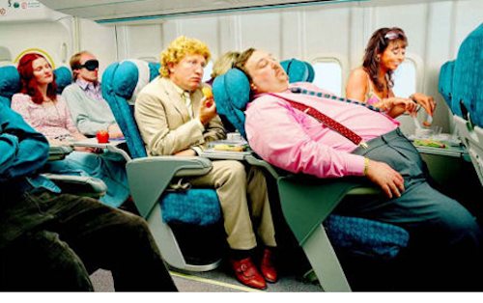

Slide 5
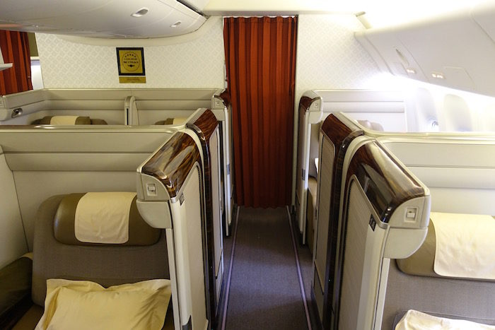

Slide 6
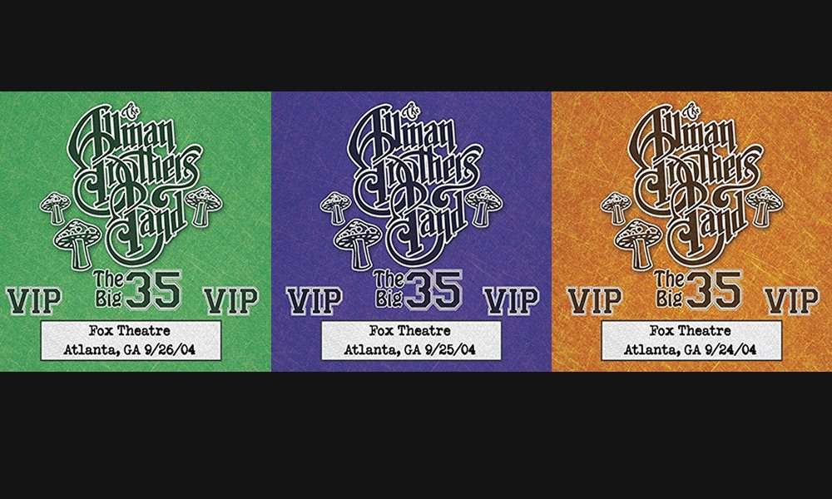

Slide 7
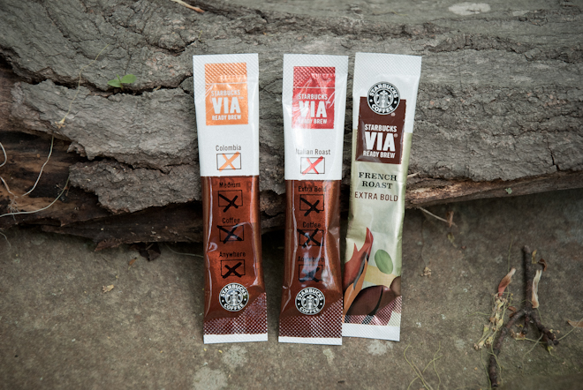

Slide 8
The Caste
God’s Contrast
Our Crime

Slide 9
The Caste

Slide 10
James 2:1-4
My dear brothers and sisters, how can you claim to have faith in our glorious Lord Jesus Christ if you favor some people over others?
For example, suppose someone comes into your meeting dressed in fancy clothes and expensive jewelry, and another comes in who is poor and dressed in dirty clothes. If you give special attention and a good seat to the rich person, but you say to the poor one, “You can stand over there, or else sit on the floor”—well, doesn’t this discrimination show that your judgments are guided by evil motives?

Slide 11
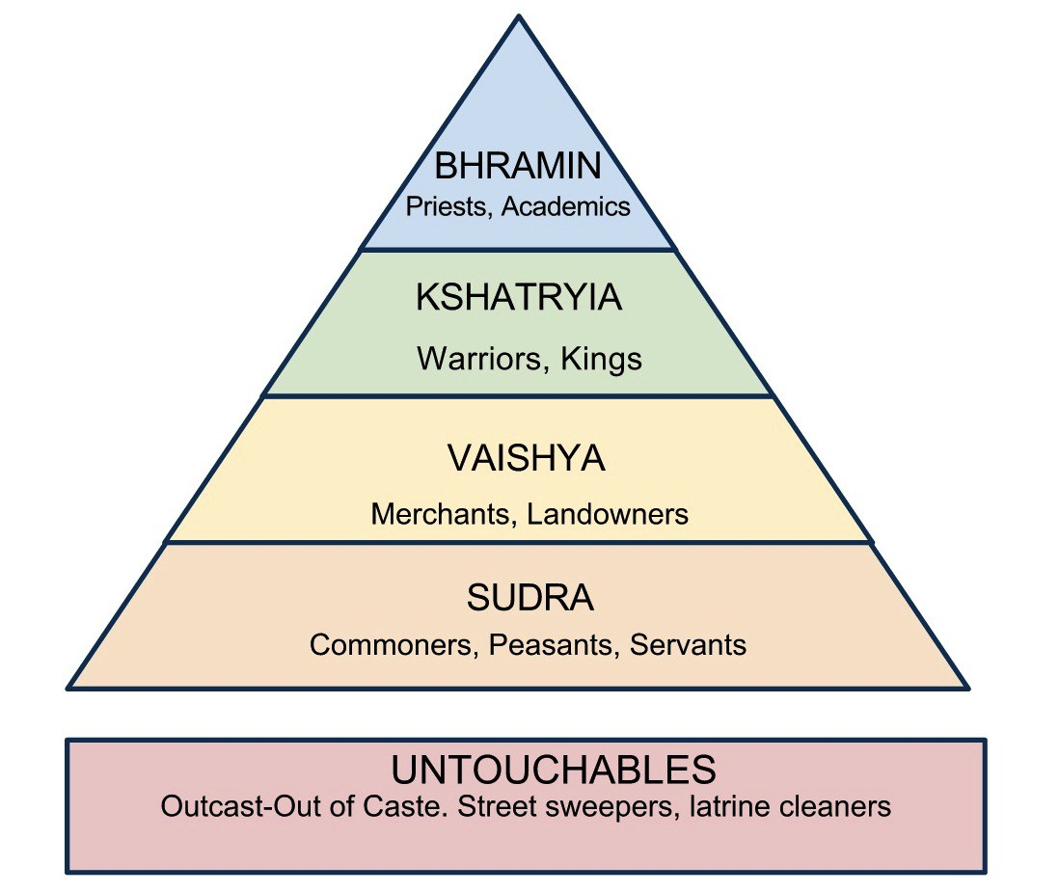

Slide 13
God’s Contrast

Slide 14
James 2:5-7
Listen to me, dear brothers and sisters. Hasn’t God chosen the poor in this world to be rich in faith? Aren’t they the ones who will inherit the Kingdom he promised to those who love him? But you dishonor the poor! Isn’t it the rich who oppress you and drag you into court? Aren’t they the ones who slander Jesus Christ, whose noble name you bear?

Slide 15
Our Crime

Slide 16
James 2:8-9
Yes indeed, it is good when you obey the royal law as found in the Scriptures: “Love your neighbor as yourself.” But if you favor some people over others, you are committing a sin. You are guilty of breaking the law.

Slide 17
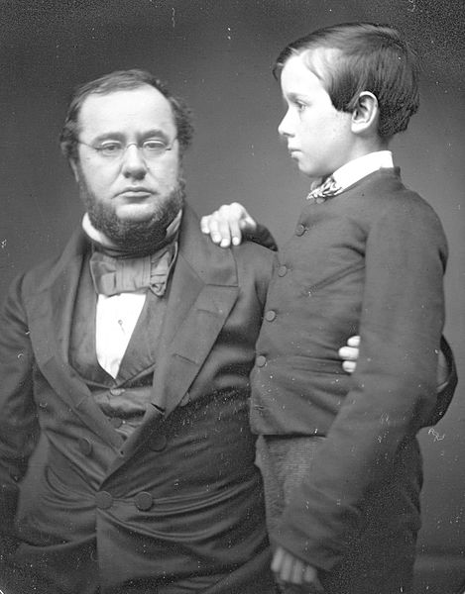

Slide 18
