Slide 2
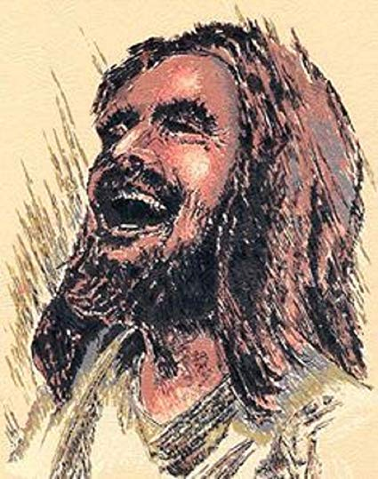

Slide 4
Proverbs 17:22
A cheerful heart is good medicine,
but a broken spirit saps a person’s strength.

Slide 5
“I have not seen anyone dying of laughter, but I know millions who are dying because they are not laughing.”
-- Dr. Mardan Kataria

Slide 6
Incongruity

Slide 7
The Gospel empowers us to laugh about…
Our Fallenness

Slide 8
“Laughter is a sense of proportion and a power of seeing yourself from the outside.”
--Zero Mostel

Slide 10
Romans 3:23
…for all have sinned and fall short of the glory of God…

Slide 11
Psalm 42:5 (MSG)
Why are you down in the dumps, dear soul?
Why are you crying the blues?
Fix my eyes on God—
soon I’ll be praising again.
He puts a smile on my face.
He’s my God.

Slide 12
The Gospel empowers us to laugh about…
God’s Grace

Slide 14
Romans 3:23-24
…for all have sinned and fall short of the glory of God, and all are justified freely by his grace through the redemption that came by Christ Jesus.

Slide 15
Proverbs 15:15
For the despondent, every day brings trouble;
for the happy heart, life is a continual feast.

Slide 17
The Gospel empowers us
to laugh about…
Eternal Life

Slide 18
“Eternity” =
Timelessness

Slide 20
Hebrews 1:9
…God has anointed you,
pouring out the oil of joy on you more than on anyone else.

Slide 21
“Jesus Christ is the happiest being in the universe. His gladness is greater than all the angelic gladness of heaven. He mirrors perfectly the infinite, holy, indomitable mirth of his Father.” –John Piper

Slide 22
“Christ was complex, but He was not confused. There were divergent notes in the music of his soul, but the result was a symphony…Through the agonies of Gethsemane and Golgotha, Jesus was sustained by indestructible joy.”

Slide 23
“God weeps with us so that we may someday laugh with him.”
--Jurgen Moltmann

Slide 24
Psalm 126:1-3
When the Lord brought back his exiles to Jerusalem,
it was like a dream!
We were filled with laughter,
and we sang for joy.
And the other nations said,
“What amazing things the Lord has done for them.”
Yes, the Lord has done amazing things for us!
What joy!

Slide 25
