Slide 2
2019 Tom and Marla Corts
Distinguished Author Series
April 16, 7 p.m. – 9 p.m.
Samford University
Wright Center

Slide 3
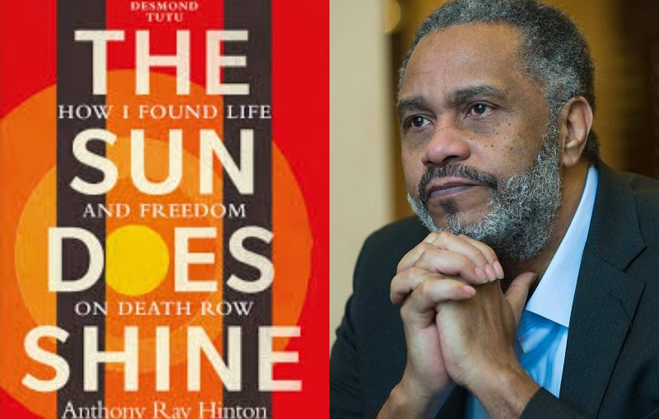

Slide 4
Ephesians 4:25-26
Let us tell our neighbors the truth, for we are all parts of the same body. And “don’t sin by letting anger control you.” Don’t let the sun go down while you are still angry.

Slide 5
Ephesians 4:32
Be kind to each other, tenderhearted, forgiving one another, just as God through Christ has forgiven you.

Slide 6
How do we forgive?
Acknowledge the hurt
2 Timothy 4:14
Alexander the coppersmith did me much harm…

Slide 7
How do we forgive?
Acknowledge the hurt
Release the hurt to God

Slide 8
2 Timothy 4:14
Alexander the coppersmith did me much harm, but the Lord will judge him for what he has done.

Slide 9
Romans 12:19
Dear friends, never take revenge. Leave that to the righteous anger of God. For the Scriptures say,
“I will exact justice;
I will pay them back,”
says the Lord.

Slide 10
How do we forgive?
Acknowledge the hurt
Release the hurt to God
Set some healthy boundaries

Slide 11
2 Timothy 4:15
Be careful of him, for he fought against everything we said.

Slide 12
Matthew 10:16
“Look, I am sending you out as sheep among wolves. So be as shrewd as snakes and harmless as doves.”

Slide 13
2 Timothy 2:16
The first time I was brought before the judge, no one came with me. Everyone abandoned me.
May it not be counted against them.

Slide 14
2 Timothy 12:17
But the Lord stood with me and gave me strength so that I might preach the Good News in its entirety for all the Gentiles to hear. And he rescued me from certain death.

Slide 16
“The biggest part of being a man is accepting responsibility, holding yourself accountable, facing some of the things that you've done, and following the three R’s process which is, I had to retrain myself. Retrain my thinking, and my responses. Then I had to retire the nonsense and retire some of the bitter feelings that I had. Just put them in a retirement. Then I had to reposition myself to get ready for something greater, something bigger.” --Oshea Israel

